Slide 1


Slide 2
Psychosocial risks during COVID-19 pandemic
  Due to the COVID-19 crisis, work arrangements and conditions are changing considerably, bringing new psychosocial challenges for the health and well-being of workers.
  Psychosocial risks emerged during the period of the rapid spread of the virus and strict isolation measures and still persist or increase over time as businesses open their doors.

Slide 3
Impact of psychosocial risks and work-related stress on the world of work
    Psychological responses: low mood, low motivation, exhaustion, anxiety, depression, burnout and suicidal thoughts
    Physical reactions: digestive problems, dermatological reactions, cardio-vascular disease, musculoskeletal disorders, headaches or other unexplained aches and pains
    Increased risk of work injuries and accidents (due to reduced accuracy)
    Impact on workplace productivity: increased absenteeism and presenteeism, lower job engagement and reduced job performance (with respect to both the quality and quantity of work)

Slide 4
Hazard identification and risk assessment during COVID-19 pandemic
    Identify the potential sources of exposure to the novel coronavirus (considering all work areas and tasks performed by workers)
    Identify any hazard that may arise due to the OSH measures and new work processes adopted to prevent contagion, including psychosocial factors, ergonomics, chemical and other hazards
    Take into account external factors affecting mental health, such as fear (of being infected, losing job, etc.), social isolation, the weight of domestic responsibilities (increased in the absence of schools and services)
    Think about new ways to detect hazards for workers at home (e.g. questionnaires and surveys)
    Consider the individual characteristics of workers when assessing the risks associated with each hazard.

Slide 5
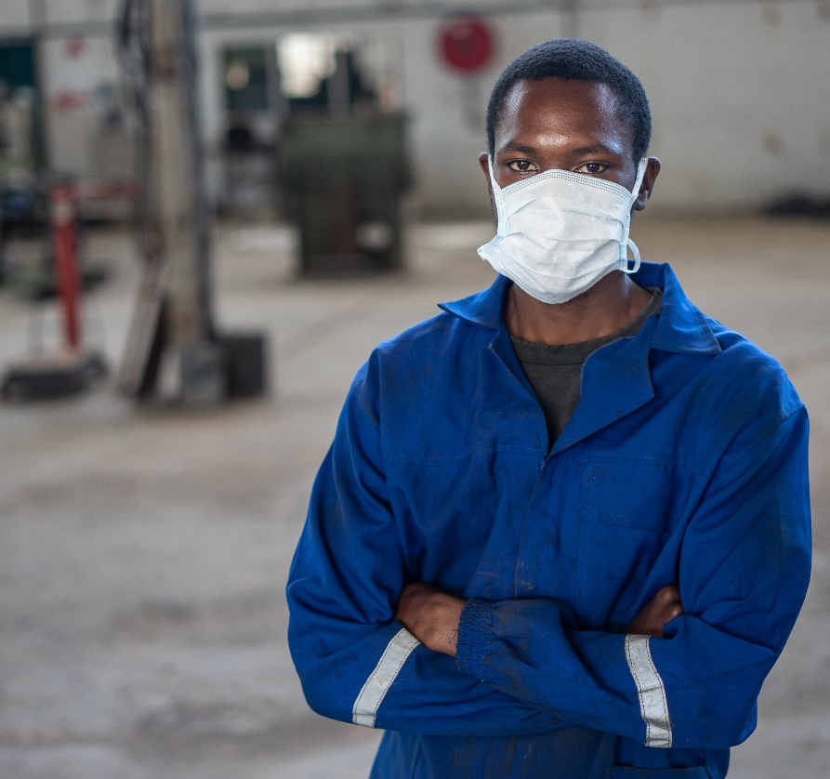
OSH measures to prevent and control psychosocial risks
    Adapted to the hazards and risks encountered by the enterprise
    Reviewed and modified if necessary on a regular basis
    Comply with national laws and regulations, and reflect good practice
    Consider the current state of knowledge, including information or reports from organizations, such as OSH services, labour inspectorates, and other services as appropriate
    Adopted in consultation with workers and their representatives

Slide 6

Areas for action
    Environment and equipment
    Workload, work-pace and work-schedule
    Violence and harassment
    Work-life balance
    Job security
    Management leadership
    Communication, information and training
    Health promotion and prevention of negative coping behaviours
    Social support
    Psychological support

Slide 7
1. Environment and equipment
  During the COVID-19 crisis, workers may face higher anxiety and stress due to the physical working environment, including the workplace layout and equipment and exposure to hazardous agents
    Fear of getting infected at work (healthcare and emergency workers; workers in jobs that require frequent and/or close contact with the general public; workers in high-density work environments or working in close proximity
    Lack of clarity about the best practices to limit the risk of exposure to the coronavirus
    Shortages of personal protective equipment (PPE)
    Prolonged use of heavy PPE (leading to fatigue, exhaustion, claustrophobia, isolation, etc.)
    Lack of appropriate equipment and inadequate physical environment (including for employees working from home)

Slide 8
1. Environment and equipment
Suggested Actions
    Adopt engineering controls and administrative measures (physical distance, promotion of good hygiene, disinfection and improved ventilation)
    When necessary, provide PPE and appropriate training, including about signs of exhaustion and dehydration (in particular in case of prolonged use of heavy PPE)
    Provide workers with the support and equipment they need to safely perform their work
    Provide practical guidance to people working from home on how to set up a safe home work environment (where to position the screen to avoid glare, minimize twisting or overreaching, etc.)
    Take into account the special needs that workers with disabilities may have in relation to new measures

Slide 9

2. Workload, work-pace, work-schedule
  During the COVID-19 pandemic, workers may experience both overwork or underwork, causing higher stress and negative effects on health and on job satisfaction
    Emergency response workers
    work under pressure, longer hours and consecutive shifts, increased workloads
    Workers in the production of essential goods, delivery & transportation, security & safety, etc.
    overtime hours and heavy workload
    Other groups of workers (including those working from home)
    either work overload or underload

Slide 10
2. Workload, work-pace, work-schedule
Suggested actions
    Assess workload and adjust and redistribute work assignments, if needed
    Review and clearly define tasks, responsibilities and results to be achieved
    Improve working methods and ensure that the necessary equipment and supports are available to help workers complete their tasks safely and efficiently
    Acknowledge and appreciate workers’ efforts in coping with the changes
    Identify and discuss possible changes with workers (starting and finishing times, over time, etc.)
    Arrange work schedules to avoid excessively long working hours and ensure adequate rest periods sufficient for recovery
    Include sufficient breaks and encourage employees working from home to have regular breaks
    Encourage relaxation exercises, stretching ore recreational activities during breaks

Slide 11
3. Violence and harassment
  The risk of violence and harassment (both physical and psychological) is likely to increase during COVID-19 pandemic, in particular:
    against healthcare workers, due to increased mortality rate, distress coupled with uncertainty about symptoms, unavailability of screening and tests, absence of vaccines and treatments, etc.
    against staff assigned to enforce measures and laws (for example, police officers and labour inspectors), due to restrictive measures against citizens' mobility and other protective measures
    against workers in the sale and transport of essential goods, due to shortage of necessary items
    cyberbullying, due to large number of people working from home and using ICT
    domestic violence, due to spending more time in close contact with violent family members (because of distancing and confinement measures)

Slide 12
3. Violence and harassment
Suggested actions
    Develop a workplace policy and ensure all staff are aware of it and abide by it
    Engineering and administrative measures to protect workers from third party violence and harassment
    Regularly consult with workers and representatives to see if violence and harassment is occurring
    Provide workers with clear instructions on how to effectively defuse hostile situations
    Establish procedures to prohibit discrimination and harassment and promote fair treatment of workers in relation to task assignments, workload and working-time arrangements
    Establish procedures to prohibit discrimination against people who have COVID-19
    Raise awareness about the effects of domestic violence and inform staff about public mitigation measures

Slide 13

4. Work-life balance
  The COVID-19 pandemic may contribute to the deterioration of workers’ work-life balance, with negative effects on their mental health and well-being and their productivity
    Limitation of social life due to restrictions aimed at limiting the contagion
    Blurring boundaries between personal lives and work (particularly when working from home)
    Additional household chores and caregiving duties, such as childcare, home-schooling and taking care of older relatives and family members

Slide 14
4. Work-life balance
Suggested actions
    Increase flexibility in working-time arrangements so workers can meet their increased responsibilities
    Inform workers about sick leave policies
    Allow workers to use annual leave and/ or parental leave if needed
    In particular, for employees working from home
    Combine flexibility with ground rules about when workers are or are not available for working order to allow them to disconnect from work at specified times reserved for rest and personal life
    Promote a focus on the quality of work rather than quantity
    Advise workers about creating a dedicated workspace free from disruptions and establishing boundaries around their working hours with their partners, children and/or house mates

Slide 15

5. Job Security
  Due to the COVID-19 crisis,
    many enterprises have closed or need to downsize, restructure or merge to survive, with dramatic impact on unemployment
    many enterprises have to change work practices and procedures to adapt to the new requirements
    many workers are worried to lose their job and incomes (increasing stress, anxiety, depression and burnout)
    job prospects with other companies and institutions are difficult to find
  Groups of workers at increased risk: workers with disabilities; young workers; workers in informal economy; casual workers; gig workers

Slide 16
5. Job security
Suggested actions
    Protect workers from unfair dismissal
    Remind workers of their rights in terms of leave, sick leave, parental and other policies
    Introduce temporary measures in order to avoid redundancies (temporarily working on reduced hours, reducing/banning overtime, reallocating workers to other tasks, etc.)
    Explore the options governments have implemented to support businesses and the workforce
    Establish plans to recover from the COVID-19 crisis and inform workers about them
    Encourage workers, their representatives, supervisors and managers to communicate openly
    Encourage workers involved in lay-offs or working part-time to take advantage of the time available to improve their skills by offering training opportunities

Slide 17
6. Management leadership
  During the COVID-19 pandemic, employers are facing difficult challenges
    multiple fronts (family, workers, customers, suppliers and business partners, governmental and financial systems)
    constant flux: spread of the contagion, rules and regulations, market challenges, temporary changes to labour law, OSH requirements, etc.
  Employers and managers find themselves under strong pressure, which generates stress.
  At the same time they have a critical role to play in protecting their workers from the stress and psychological pressure generated by the pandemic.

Slide 18
6. Management leadership
Suggested actions
    Be informed by reliable information from national and local authorities regarding the pandemic
    Ensure that you have clear business plans and OSH protocols and fine tune them as necessary
    Give priority to the safety of workers
    Share purpose and values with your workers, giving them a sense of belonging
    Make a clear commitment to actively help workers promote and protect their physical and mental health
    Take advantage of the new experience of the pandemic to set up positive changes that will last
    Focus on moving the enterprise and workforce beyond the emergency and prepare for the future
    Be a role model for your staff: take OSH seriously, including related to stress and mental health

Slide 19

7. Communication, information and training
  Extensive media coverage of the epidemic is essential to encourage precautionary and preventive measures, but it can also influence the psychological response to the infectious disease threat, amplifying apprehension, worries and anxiety.
  The increasing amount of fake news and misinformation surrounding the COVID-19 crisis is detrimental to people’s mental health and well-being.
  Fake news can increase stereotypes, prejudice and discrimination. It can also lead to confusion over what information is true or false, impairing the adoption of adequate preventive measures and exposing people to behaviours that may endanger their health.

Slide 20
7. Communication, information and training
Suggested actions (I)
    Be clear and specific with your messaging, focus on what workers need to know
    Create an environment of open, honest and effective communication
    Inform workers about the results of risk assessment and train them in the OSH measures/procedures implemented to prevent COVID-19, including in the proper use of PPE.
    Inform workers about their OSH rights and responsibilities
    Inform workers about and train them in workplace procedures in the event they have symptoms of and testing positive for COVID-19
    Ensure that all the relevant information is accessible to persons with disabilities and other workers who might not be fluent in the official language (such as migrant and indigenous workers)

Slide 21
7. Communication, information and training
Suggested actions (II)
    Train managers and supervisors to act as role models
    Train managers and supervisors in how to recognize signs of depression and stress disorder and detect violence and harassment
    Teach calming skills and maintenance of natural body rhythms (for example, nutrition, sleep, rest and exercise)
    Train people working from home in how to work from home safely and effectively, taking into account ergonomic and other physical risks, as well as psychosocial risks
    Educate managers about best practices for dealing with remote workers, so they are better able to mentor and support their teams
    Respect workers’ privacy

Slide 22
8. Health promotion and prevention of negative coping behaviours
  Lockdown and physical distancing, school closures, quarantines, working from home brought profound changes to normal routines, increasing the risk of these unhealthy behaviours, which may affect both physical and mental health and have negative impact on job performance.
  Psychosocial risks and work-related stress are associated with unhealthy behaviours, including
    heavy alcohol consumption
    increased cigarette smoking
    poor eating habits
    less frequent physical exercise
    irregular sleep patterns

Slide 23
8. Health promotion and prevention of negative coping behaviours
Suggested actions
    Revise working-time arrangements to improve sleep, rest and reduce fatigue
    Inform and educate workers about health routines for sleep
    Encourage regular exercise, including by providing information on how to exercise at home
    Encourage healthy habits such as regular breaks, not missing meals and making informed food choices
    Provide training and resources on alcohol and drugs and services available
    Train managers and supervisors to identify changes in job performance and behaviour that may indicate potential substance abuse, so they can refer them to support services
    When food is provided at work, make healthy options available

Slide 24
9. Social support
  Many measures adopted to fight the COVID-19 pandemic (such as lockdown, physical distancing and working from home) make social interaction more difficult, both within and outside work, increasing feelings of isolation and loneliness
    Workers in emergency sectors having to isolate themselves from loved ones at home
    When workers return to the workplace, measures adopted to prevent contagion also affect social interactions
    Employees working from home who were previously accustomed to “office life” may find the shift quite difficult, causing a deterioration in their mental health

Slide 25
9. Social support
Suggested actions
    Use supportive approaches for teams
    Organize regular virtual meetings to enable workers to share their concerns about the procedures implemented to deal with the COVID-19 crisis and ensure that their opinions are duly considered
    Make sure that workers can ask for support when in need of assistance
    Establish channels for workers to express their fears in this unprecedented situation and to ask questions about the risks to their health and well-being
    Encourage workers to stay virtually connected and maintain social networks
    Establish close management – worker relations
    Value and recognize good work performance and the positive contribution of workers

Slide 26

10. Psychological support
  The mental health toll of the COVID-19 pandemic may be significant for many workers, who are exposed to different psychosocial risks, emerged or exacerbated by the crisis.
  In workplaces where adequate psychological support is provided, workers experiencing work-related stress and other mental health problems are more likely to seek, and receive, appropriate help.
  This will help them to have a quicker recovery and more sustainable return to work.

Slide 27
10. Psychological support
Suggested actions
    Integrate psychological support initiatives into the workplace COVID-19 response plan
    Create a buddy system to monitor stress and burnout and to provide psychological support
    Pay attention to workers with pre-existing mental health conditions who may need further support
    Make stress reduction and self-calming techniques available (such as, online relaxation and meditation classes, tutorials and apps)
    Inform both managers and workers about how they can access mental health and psychosocial support services and counselling programmes and facilitate access to such services, including employee assistance programmes (EAP)
    Maintain confidentiality about the services provided to individual workers

Slide 28
Resources
    Press Release: Protect workers both now and after lockdowns ease, says ILO
    Report: In the face of a pandemic: Ensuring Safety and Health at Work
    Checklist: Prevention and Mitigation of COVID-19 at Work ACTION CHECKLIST
    Expert Panel Discussion Webinar Recording: Safety and health at work and COVID-19
    Think Pieces: Original and exclusive think pieces on the OSH response to the Covid-19 pandemic from the global OSH community
    Publication: A safe and healthy return to work during the COVID-19 pandemic
    Ten Action Points: Safe Return to Work: Ten Action Points
    Mental health and COVID-19: Managing work-related psychosocial risks during the COVID-19 pandemic

Slide 29
Thank you
For more information, please contact:
The ILO Labadmin/OSH Branch
labadmin-osh@ilo.org
Manal Azzi (Senior OSH specialist)
azzi@ilo.org

