Slide 1



Improving the Safety and Health of Young Workers
28 April 2018
World Day for Safety
and Health at Work
Notes:
This year, the World Day for Safety and Health at Work focuses on improving the safety and health of young workers and is part of a joint campaign, linked with the 2018 World Day Against Child Labour (marked on 12 June), which will address hazardous child labour.
Following the Singapore World Congress on Safety and Health at Work and its SafeYouth@Work Congress and the Fourth Global Conference on the Sustained Eradication of Child Labour, the campaign will build upon a year-long effort to focus attention on the creation of a future generation of safe and healthy workers, decreasing the incidence of occupational injuries and diseases among young workers and reducing the number of children performing hazardous work.
The joint campaign focuses on what needs to be done to accelerate action to achieve Sustainable Development Goal (SDG) target 8.8 of safe and secure working environments for all workers by 2030 and SDG target 8.7 of ending all forms of child labour by 2025. Achieving these goals for the benefit of the next generation of the global workforce requires a concerted and integrated approach to eliminating child labour and promoting a culture of prevention on occupational safety health (OSH).

Slide 2

What is meant by “young workers”?
Notes:
Young workers represent more than 15 per cent of the world’s labour force, accounting for approximately 541 million people.
But what do we mean by ‘young workers’?

Slide 3
Youth are persons between the age of ending compulsory education and embarking on their first job (15–24 years old)
Young workers can be divided in 2 major groups:
above the minimum age of employment but under the age of 18
between age 18 and 24
Notes:
The term “youth” often refers to persons who are at the age where they are ending compulsory education and embarking on their first work experience. For statistical purposes, the United Nations define this category between the ages of 15 and 24.
According to international standards, age 18 is the dividing line between childhood and adulthood. Thus, young workers fall into two major groups.
1. The first one includes young workers above the minimum age of employment but under the age of 18. They are considered “children” and they are often protected by specific restrictions on the types of work that they may do, the hazards to which they may be exposed and the hours that they may work. These restrictions are intended to protect children’s health and safety and reduce their risk of injury and disease.
2. The second group consists of young workers between ages of 18 and 24. They are considered adults and are covered by the general laws and regulations on employment and working conditions applicable to all adult workers. Despite their relative lack of job experience, their continuing mental and physical development, and their vulnerability to workplace harm, they may be legally employed in almost any job without the task and hours restrictions that apply to young workers who are above the minimum age of employment but under the age of 18.

Slide 4
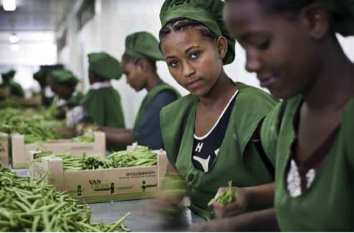
Are young workers more at risk of suffering occupational injuries and diseases?

Slide 5
Statistics show that young workers experience much higher rates of non-fatal occupational injuries than adult workers
In the EU: more than 40% higher among young workers aged 18–24
In the US: two times higher among young workers aged 15–24
Notes:
The answer is yes!
Young workers experience significantly higher rates of occupational injury than adult workers.
According to recent European data, the incidence of non-fatal injury at work was more than 40 per cent higher among young workers aged 18–24 than among older workers.
In the United States, the risk that young workers aged 15–24 will suffer a non-fatal occupational injury is approximately twice as high as that for workers aged 25 or older.
As well as causing incalculable human suffering, the cost to society of young workers being seriously injured and experiencing long-term impairment as a result can be much greater than the cost to society of adult workers sustaining similar injuries. The consequences of occupational injuries are more serious when these injuries occur at the beginning of a young person’s working life. A young worker with a long-term impairment could cease to be an active member of society and make little use of the education and training that they have received.

Slide 6
Young workers are also more vulnerable to work-related diseases…
but most of statistics do not capture this situation because of cumulative exposure, long latency period, difficulty of capturing accurate data, etc.
Notes:
Statistics indicate that the incidence of occupational diseases is lower among young workers than among older workers.
However, this is not due to young workers having greater resistance to occupational diseases.
Young workers are in fact more vulnerable to occupational diseases because they are still developing, both physically and mentally, and this makes them more susceptible to harm from hazardous chemicals and other agents.
The lower incidence of occupational diseases among young workers is most likely due to the fact that occupational diseases often occur only after cumulative exposure and/or a latency period. Moreover, it is difficult to obtain accurate data on occupational diseases, and this is particularly the case with data on occupational diseases caused by the exposure to workplace hazards during youth.

Slide 7
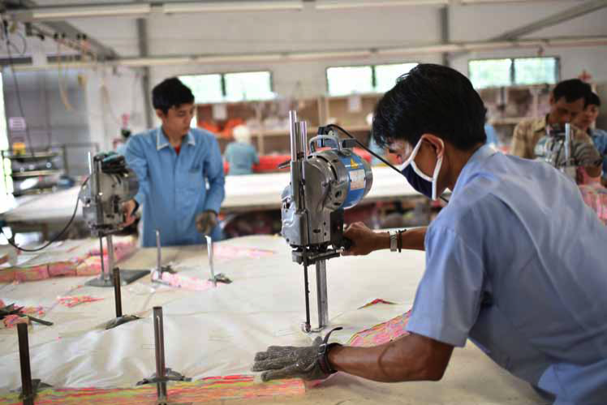
Why are young workers more at risk?
Notes:
Many different factors interact to increase the risk of young workers suffering occupational injuries and diseases.
What are some of these factors that threaten the safety and health of young workers?

Slide 8
Risk factors specific to young workers
  Inherent to their age
  Physical stage of development
  Psychological stage of development
  Influenced by their age
  Job skills and work experience
  Educational level
Other factors which in combination with young age increase OSH risks (gender, disability, migration status)
Notes:
Various risk factors that are specific to young workers increase their likelihood of suffering harm from workplace hazards.
These risk factors can be inherent to their age, such as the stage of physical, psychosocial and emotional development. The body of young workers (especially adolescents) is still developing. Their reproductive systems and brain functions are particularly susceptible to hazards that interfere with the organs involved. Young workers also tend to be less able to discern the consequences of their actions or to assess risks associated with various situations, and are more susceptible to social and motivational pressures, including the desire to belong, to be considered attractive, and to achieve independence. These traits affect young people’s decision making and can result in risk taking. They can also make young workers reluctant to speak up about difficulties related to doing their work or about hazardous physical and psychological conditions.
Other specific factors can be influenced by their age. For example, young workers often lack the skills and experience that they need for the work to which they are assigned, including an understanding of the safety and health hazards and risks associated with it. Awareness of workplace safety also appears to be positively influenced by education. More highly educated workers have a better understanding of safety, are most compliant with safety procedures and record lower accidents than workers with less education.
There are also a number of other cross-cutting factors work that in combination with age increase the risk of occupational accidents and diseases to which young workers are exposed. These include gender, disability and migration status. For example, young people with disabilities tend to be at higher risk for exclusion, isolation, bullying and abuse, and they also tend to have fewer educational and economic opportunities. Young boys appear to be more likely to be engaged in hazardous work and to suffer more occupational injuries than young girls, but relevant figures may be biased because young girls are more likely to be working in informal employment, often unpaid family work, and this makes them “invisible” and, consequently, less likely to feature in official statistics. Finally, migrant workers have occupational accident rates that are among the highest experienced by any group. Language barriers, cultural attitudes and behaviours, their employment status (most of migrant workers are in precarious and seasonal work) and their need to prioritize income over all other considerations may prevent them from raising any safety and health concern.

Slide 9
Young workers’ exposure to work hazards
  Safety hazards
  Physical hazards
  Biological hazards
  Chemical hazards
  Ergonomic hazards
  Psychosocial hazards
Notes:
Several different kinds of hazard can exist in every workplace, with specific consequences for the safety and health of young workers.
Work hazards include safety hazards (e.g., working at height; using dangerous machinery or tools; driving or working near vehicles; walking on slippery surfaces; working close to flammable or explosive materials; etc.); physical hazards (e.g.: noise, vibration, extreme temperatures, radiation, etc.); biological hazards (e.g.: exposure to bacteria, parasites, viruses, dangerous animals, insects and plants, which can result in different types of disease); chemical hazards (including gases, dusts, fumes, vapours and liquids); ergonomic hazards (e.g.: carrying heavy loads, fast or repetitive movements, poorly designed machines, equipment and work processes that cause workers to adopt awkward positions) and psychosocial hazards (e.g.: task design, workload and pace of work, work schedules, decision-making power and control, organizational culture, work-life balance, interpersonal relationships at work, including workplace violence and harassment. etc.).
Young workers can be particularly vulnerable to these hazards.
For example, exposure to toxic chemical when young can cause serious harm to reproductive systems and hormonal balance.
Adolescents carrying heavy loads face higher risk of musculoskeletal disorders (MSDs) such as skeletal damage and impaired growth.
Young workers appear to be more vulnerable to workplace violence and harassment, including unwanted sexual attention because of a combination of different factors including type of work, form of employment and low bargaining power. Poor work-life balance is also common among young workers, in part because they tend to accept shift work, seasonal work, weekend work and overtime.

Slide 10
Young workers’ presence in
informal economy
non standard form of employment
high-risk sectors (e.g. agriculture & construction)
Notes:
As young workers tend to have limited job skills, work experience and bargaining power, their opportunities are often limited to entry-level jobs and jobs that are undesirable because of low pay, excessive hours, precariousness and the hazardous nature of the work. This situation is exacerbated by a youth unemployment rate that currently runs three times higher than that of adults.
Furthermore, large numbers of young people work in the informal economy (78.7 per cent of workers between the ages of 15 and 29), where they are more vulnerable to occupational accidents and diseases because informal economy jobs tend to give workers significant exposure to work hazards and provide them with limited social protection coverage.
Young workers are much more likely than adults to be engaged in non-standard forms of employment, where jobs are less stable and less protected. Those who are engaged in temporary work tend to have limited access to training and skills development because their work is only short-term, and they are usually less informed about hazards and risks at work. They tend to need to change jobs often, and as a result rarely have the time or opportunity to become familiar with the OSH rules before they have to change and adapt again.
Young workers are often employed in very hazardous sectors, such as agriculture and construction.
Agriculture is considered one of the most hazardous sectors for workers of all ages. Agricultural workers have high rates of occupational accident and disease, as they are exposed to a variety of hazards. Even though employment in agriculture is declining for both young and older workers, agriculture remains a major employer of young people in developing regions around the world.
Construction is attracting an increasing number of young workers in developing and emerging regions (Africa, Asia and the Pacific, Latin America and the Caribbean). Construction has one of the highest rates of occupational accidents and diseases of all industries, mainly because of the very hazardous nature of many construction tasks (e.g.: use of dangerous machinery and materials, work at height, etc.) and the characteristics of this sector (e.g.: the high proportion of small firms and extended contracting chains, multi-employer worksites, high turnover and the extensive use of inexperienced, seasonal and migrant workers).

Slide 11
World Day for Safety and Health at Work 2018
Improving the safety and health of young workers

Slide 12
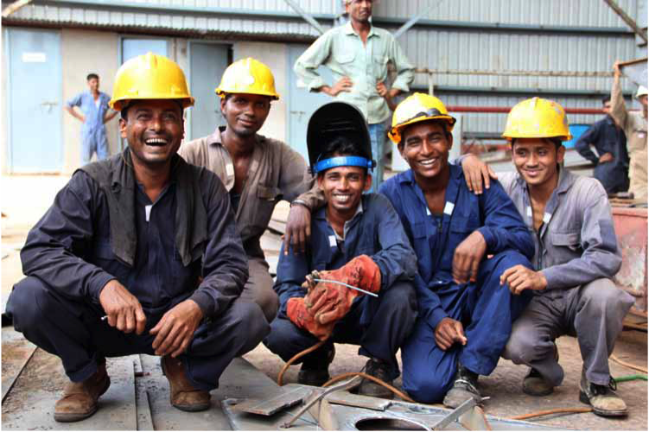
What are some ILO standards protecting young workers’ safety and health?
Notes:
The ILO promotes decent work for all women and men through the adoption of international labour standards.
So, what are the ILO conventions and recommendations protecting the safety and health of young workers?

Slide 13
OSH Standards
Promotion of decent, safe and healthy work environments for all workers, including young workers
ILO key Conventions establishing essential principles on OSH
  Convention 155 (Occupational Safety & Health)
  Convention 161 (OSH services)
  Convention 187 (Promotional framework for OSH)
  Few OSH conventions with special measure for young workers
Notes:
The right to safe and healthy work for all workers, including both young and adult workers is recognized by the ILO Constitution (1919) , the Philadelphia Declaration (1944) and more than 40 international labour standards on OSH.
The key ILO standards on OSH establish the essential principles on OSH.
The Occupational Safety and Health Convention, 1981 (No. 155) set out the basic principles for national and enterprise-level policies and strategies to improve OSH. The Convention defines employers’ responsibilities, the rights of workers and their representatives, and requirements regarding information, education and training.
The Occupational Health Services Convention, 1985 (No. 161) provide for the establishment of enterprise-level occupational health services.
The Promotional Framework for Occupational Safety and Health Convention, 2006 (No. 187) promote an OSH culture of prevention through the development and implementation of national policies, systems and programmes on OSH. The accompanying Recommendation No. 197 states that the national system should implement appropriate measures for the protection of all workers, in particular workers in high-risk sectors and vulnerable groups of workers such as those in the informal economy, migrant and young workers.
While most of ILO OSH conventions provide for the protection of all workers from occupational accidents and diseases, some set out specific measures for the protection of young workers.
The Construction Recommendation, 1988 (No. 175) requires a minimum age (as prescribed by national laws or regulations) for drivers and operators of lifting appliances (Para. 29).
The Asbestos Recommendation, 1986 (No. 172) requires to devote special attention to the employment of young persons of less than 18 years of age in activities involving a risk of occupational exposure to asbestos.
The Conditions of Employment of Young Persons 1965 (Underground Work) Recommendation (No. 125) calls for the adoption of measures to protect the life and health of young workers in underground mines.
The Welfare Facilities Recommendation, 1956 (No.102) in its Paragraph 16 (1) states that in undertakings where any workers, especially women and young workers, have in the course of their work reasonable opportunities for sitting without detriment to their work, seats should be provided and maintained for their use.
For example, the Medical Examination of Young Persons (Industry) Convention, 1946 (No. 77), the Medical Examination of Young Persons (Non-Industrial Occupations) Convention, 1946 (No. 78) and the Medical Examination of Young Persons (Underground Work) Convention, 1965(No. 124) require that there be pre-employment medical examinations for children and young persons under the age of 18 years, in order to check their fitness for the work in question, and they require that there be medical supervision until workers reach the age of 18. These requirements are extended to the age of 21 for occupations that involve high health risks. The Medical Examination of Young Persons Recommendation, 1946 (No. 79) in fact recognises that in most cases, the adolescent stage of development does not end at 18 years of age. Consequently, special protection is still needed beyond the age of 18, and it is desirable to extend the age limit for compulsory medical examinations to at least 21 years for all young workers employed in industrial or non-industrial occupations. This extension should apply to, but not be limited to, all mining occupations, all employment in hospitals, and employment in public entertainment such as dancing and acrobatics.
The Safety and Health in Agriculture Convention, 2001 (No. 184) has a section on young workers and hazardous work. The accompanying Recommendation (No. 192) provides for the adoption of health surveillance measures for young workers.

Slide 14
Child Labour standards
Special protection for children (until 18 years old)
Minimum age for admission to employment (depending of type of work)
  Convention 138 (Minimum Age)
Hazardous work as one of the four worst form of child labour
  Convention 182 & Recommendation 190 (Worst Forms of Child Labour)
Notes:
A young worker under the age of 18 is still considered a child and protected by child labour standards.
The Minimum Age Convention (No. 138) determines the minimum age for employment in different types of work and in countries exhibiting different levels of development. Article 3 provides that the minimum age for any type of employment or work that by its nature or the circumstances in which it is carried out is likely to jeopardize the health, safety or morals of young persons shall not be less than 18 years with some exceptions.
The Worst Forms of Child Labour Convention (No.182) includes hazardous work as one of the four worst forms of child labour, the elimination of which is considered an urgent priority for national and international action. The convention requires that national authorities, in consultation with organizations of employers and workers, develop a hazardous work list. This list should take into account the kinds of hazardous work referred to in the Worst Forms of Child Labour Recommendation (No. 190). These include:
work that exposes children to physical, emotional or sexual abuse
work that takes place underground, under water, at dangerous heights, or in confined spaces
work with dangerous machinery, equipment and tools, or work that involves the manual handling or transport of heavy loads
work in an unhealthy environment, which may, for example, expose children to hazardous substances, agents or processes, or to temperatures, noise levels, or vibrations damaging to their health
work under particularly difficult conditions, such as work for long hours or during the night, or work that does not allow for the possibility of returning home each day.

Slide 15
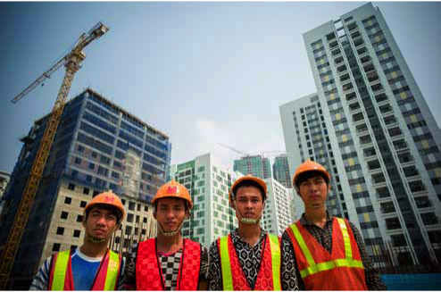
What can be done to improve OSH for young workers?
Notes:
So, what can be done at regional, national and local levels to improve OSH for young workers?

Slide 16
Focus on 5 main areas related to OSH
Notes:
Five main areas for action have been identified.
The following slides will present these five areas for action. Good examples are mentioned. Participants are encouraged to consult the the ILO Brief “Improving the safety and health of young workers” for more elaborated information and examples.

Slide 17
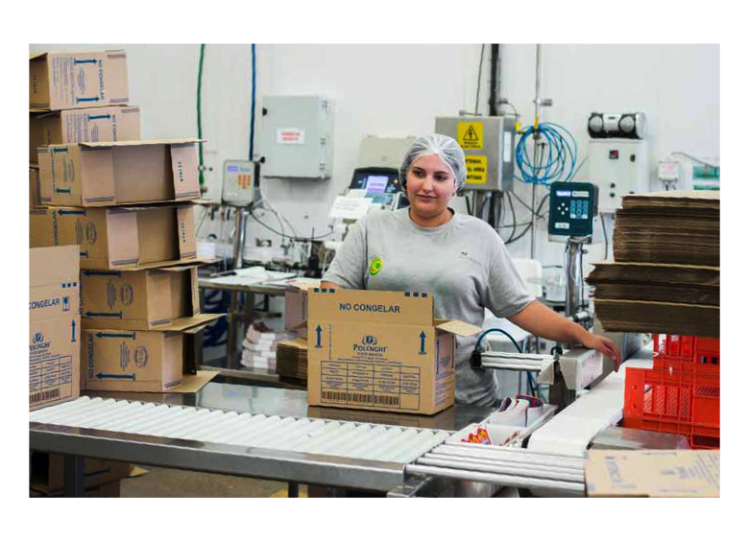
Improve the collection and analysis of data and information on OSH and young workers
Notes:
1. Improvement of the collection and analysis of data and information on OSH and young workers.
The development of an effective OSH system at the national and enterprise levels requires reliable data on OSH, such as data on occupational accidents and diseases. Accurate data in fact are critical for identifying workplace hazards, hazardous sectors and vulnerable groups of workers; as well as for setting priorities and measuring progress. Reliable OSH data on young workers are also essential to the development of preventive measures tailored to such workers.
A good example of improving the recording and notification system is the Ec-ulat: a work accident reporting system in the Philippines, which encourages not only employers, but also workers and the public, to report accidents when they see them happen.
Young workers should be encouraged to participate in the reporting of workplace accidents. Without encouragement and reassurance, young workers often fear that speaking up about a workplace injury will result in their employer acting in a way that is unfavourable to them. This perception jeopardizes the important contributions that they can make to OSH measures. All workers should understand the importance of reporting occupational accidents and diseases to the employer and be able to do so without facing disciplinary measures.

Slide 18
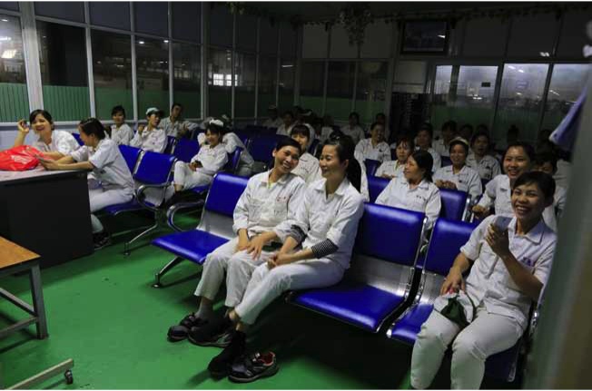
Develop, update and implement policies, laws, regulations and guidelines to better protect the safety and health of young workers
Notes:
2. Development, update and implementation of policies, laws, regulations and guidelines to better protect the safety and health of young workers.
A national OSH policy should aim at the development of a national preventative safety and health culture. Priority areas for action and workers at higher risk, such as young workers, should be identified and addressed when developing such policies.
For example, the Spanish strategy on OSH for 2017-2020 prioritizes the promotion of OSH for young workers.
Laws and regulations should reflect international standards on improving OSH and eliminating child labour. The concern for the safety and health of young workers should not be limited to young people under the age of 18; it should extend to all young workers. It should be expressed in national laws, regulations and policies that address the risk factors that cause young workers to suffer harm from workplace hazards.
A good example is the Andean Community’s OSH Instrument , which include specific requirements for the employment of young workers.
Labour inspection has a critical role to play in protecting the safety and health of young workers. Initiatives by labour inspectorates targeting child labour and the safety and health of young workers in very hazardous jobs and sectors can be very effective in enhancing the health and safety of young workers.
For good example is the Labour Inspection Blitz in Ontario (Canada), conducted in the industrial sector, focusing on young workers and new workers who had been on the job for less than six months.
Final responsibility for compliance with OSH laws and regulations lies with employers. Many OSH legal frameworks require that employers adopt OSH management systems and practices that include activities aimed at prevention, such as risk assessment and control, training and information for workers, surveillance of workers’ health, emergency planning, investigations into accidents, and the recording and notification of occupational accidents and diseases. Many countries have also introduced legislation requiring that OSH committees be established and OSH workers’ representatives appointed. Employers should ensure that risk factors specific to young workers are recognized and addressed by such management systems and practices. Young workers should also be specifically included in mechanisms for worker consultation and collaboration on OSH.
Governments and other national institutions, such as employers’ and workers’ organizations, should develop guidelines and tools to promote compliance with OSH requirements, improve working conditions and prevent risks in the workplace. These tools should include a specific focus on young workers’ needs.
For example, where the Australian Fair Work Ombudsman produced two guides that describe best practices with respect to young workers: one for employers and one for young workers.

Slide 19

Build capacity aimed at helping governments, employers and workers and their organizations address the OSH needs of young workers
Notes:
3. Capacity building aimed at helping governments, employers, workers and their organizations address the OSH needs of young workers.
To fulfil their duty to protect workers’ safety and health, employers should be familiar with the process of risk management, which include the identification of work hazards, the assessment of the associated risks, taking into account for specific worker vulnerabilities, and the adoption of effective prevention and risk control measures. Employers’ organizations have a critical role to play in helping their members acquire adequate skills and understand the importance of risk management.
Collaboration with workers is necessary for the improvement of working conditions. In order to adequately represent young workers, OSH representatives need to be aware of the risk factors that young workers face and they should be provided with information and guidance on how to address the OSH vulnerabilities of young workers.
A good example is the guide Apprenticeships: A short guide for union safety representatives developed by the UK Trade Union Congress (TUC) and Learning and Skills Council (LSC). The guide recommends a number of approaches that can be taken, such as encouraging young workers and apprentices to join the union; making young workers a standing item on the OSH committee agenda; checking that young workers have the necessary education in OSH; etc.
Governments, employers’ organizations and trade unions must play an important role in bringing about OSH in the informal and rural economies, both of which employ large numbers of young workers and child labourers, and in which hazardous working conditions are often found.
For example, The Ghanaian General Agricultural Workers' Union together with ILO's International Programme on the Elimination of Child Labour (IPEC), developed a manual for cocoa communities entitled “Eliminating hazardous child labour and Occupational Safety, Health and Environmental risks - A Manual for agents of change in cocoa communities in Ghana”, which address the vulnerability of children and adolescents to the effects of hazardous work in cocoa farming.

Slide 20
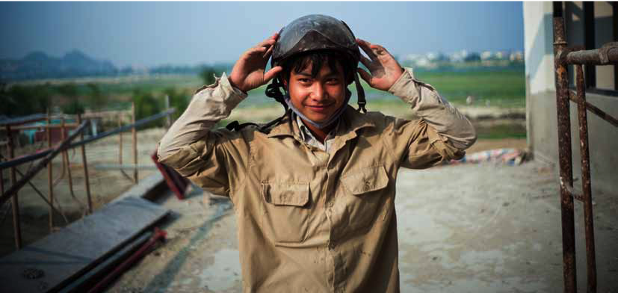
Integrate OSH into general and vocational education to build a safer and healthier generation of workers
Notes:
4. Integrating OSH education into general education and into vocational training programs
It is a highly effective way of building OSH awareness, knowledge and skills among young workers and young employers. As young people are the future of any society, and important drivers of cultural change, basic OSH information should be integrated into school curricula, technical training and educational programmes. This would help ensure that young people are aware of the need to protect their safety and health, and that they are aware of their right to do so.
In some countries, basic education on risk prevention is included in primary school curricula. In others, experts are developing an approach that focuses not only on educational content, but also on the premises at which the teaching is carried out. Pupils and young students are called on to play an active role in health and safety-related aspects of their school environment, as part of their learning.
A good example is the European Union “whole-school” approach to OSH, which integrates risk education and school safety and health into all the school’s activities and systems and actively involves staff and pupils in hazard spotting and in proposing solutions, developing their skills and giving them a sense of ownership with respect to their school’s safety rules.
A recent study conducted by the French National Research and Safety Institute for the Prevention of Occupational Accidents and Diseases (INRS) found that for young workers who received OSH teaching at school, the occupational accident rate was 50 per cent lower than for young workers who did not.
Effective OSH education enables young people to adopt prevention-oriented attitudes and behaviours; develop the skills and abilities needed for the identification of hazards and risks; and develop effective OSH solutions, whether these young people be in school, at work, or otherwise contributing to society.
For example, the Canadian Centre for Occupational Health and Safety (CCOHS), developed the Health + Safety Teaching Tools to provide support to teachers who are educating their students about staying healthy and safe when they enter the workforce.
The U.S. National Institute for Occupational Safety and Health (NIOSH) designed the Youth@Work—Talking Safety to teach young people OSH basics . This free curriculum has been customized for each state in the United States so that it is consistent with the state’s own child labour rules and regulations.
The California Partnership for Young Worker Health and Safety has created the Young Worker Resource Centers in California, which provide information, training, educational materials, technical assistance and referrals to help educate young people, employers and the community about OSH and the protection of young workers.

Slide 21
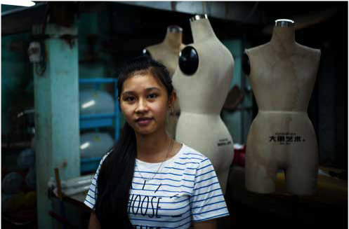
Strengthen advocacy, awareness and research on young workers’ vulnerability to OSH hazards and risk
Notes:
5. Strengthening advocacy, awareness and research on young workers’ vulnerability to OSH hazards and risks
Continuing support for conducting and disseminating OSH research on young workers is critical. Hopefully, an increasing number of OSH agencies and institutions are studying young workers.
There are some important things that future research should consider:
Relation between OSH risk and transitions young workers are experiencing, such as transition from school to work and from youth to adulthood.
Multi-dimensional and comprehensive approach, exploring the ways in which different factors work together to contribute to young workers’ increased vulnerability to OSH risks. For example, examining young person-specific characteristics and also working conditions, work organization and workplace characteristics.
Social, emotional and motivational issues, such as peer pressure and support, workplace norms and values, OSH culture, and management style. They may have a significant influence on young workers’ behaviour and their willingness to speak out about OSH issues.
OSH training and supervision, investigating the impact of high-quality and effective (a) ways of introducing OSH; (b) OSH training and supervision of young workers; and (c) strategies for ensuring that OSH training and supervision are conducted, particularly in non-standard forms of employment.
Adapting OSH management systems to young workers, examining the ways in which OSH management systems and risk assessments can be enhanced to include the specific risk factors that young workers face.
Awareness-raising campaigns on OSH and the use of real-world experiences are effective ways of disseminating essential information and of sensitizing workers, parents, employers, schools, and communities about young workers’ rights and vulnerabilities. These campaigns can be organized by governments or national institutions, employers’ organizations, trade unions, youth associations, NGOs, and other civil society organizations.
For example, the Hong Kong OSH Council launched the Youth Occupational Safety and Health Promotional Campaign , which includes the distribution of OSH information kits, the organizing of seminars and the airing of radio programmes that stress the importance of OSH for young workers.
Trade Unions are increasingly recognizing the importance of affiliating young workers and engaging them directly in the organization of campaigns and actions to promote their rights at work.
For example, the International Trade Union Confederation (ITUC) adopted the Economic and Political Agenda for Young Workers in 2017.
The Victorian Trades Hall Council (Australia) created a Young Workers Centre to organize young workers and empowering them with the knowledge and skills needed to fight for safe and secure jobs.

Slide 22

The voice of young workers on OSH matters
Notes:
Young workers need to advocate for their labour rights, including the right to safe and healthy work adapted to their needs.
But, how can they voice their concerns?

Slide 23
Engage young workers in building a culture of prevention on OSH
  Provide youth with the resources and the opportunities they need to meet the challenge of determining their future
  Involve young workers and their organizations in the development and implementation of measures and programmes aimed at preventing occupational accidents and diseases
Notes:
A culture of prevention on OSH means that there is respect for the right to a safe and healthy work environment at all levels, and that governments, employers, and workers actively participate in securing a safe and healthy work environment through a system of defined rights, responsibilities and duties. The principle of prevention is given high priority.
When building a sustainable culture of prevention with respect to OSH, special attention should be given to hazardous sectors and industries and to vulnerable workers, such as young workers employed in workplaces where the risk of workplace harm is high.
Directly involving young workers and their organizations in the development and implementation of such preventive culture is critical, as it makes it possible for their concerns to be addressed during the discussion about how to create a generation of safe and healthy workers.
Civil society and traditional OSH institutions and their social partners often lack the knowledge and means to advocate effectively on young people’s behalf.
Moreover, because large numbers of young workers are involved in non-standard forms of employment and in informal work, they are “invisible” and deprived of bargaining power and effective representation. Their relative lack of power and voice contributes to the unfortunate situation whereby young workers a group are overlooked in the OSH legal and policy framework, and also overlooked during the design of OSH training and awareness campaigns, and when research priorities are determined.
Public institutions must be prepared to support young people in their efforts to determine their future by providing them with resources and opportunities to be actively engaged.

Slide 24
Safe Youth @ Work Action Plan
September 2017: Safe Youth @ Work Congress
Consultative sessions with youth champions during high level international and regional forums
Inputs from OSH experts
Drafting committee in ILO HQ Geneva
April 2018: Launch of the Safe Youth @ Work Action Plan
Notes:
The engagement of young people was a key element in the development of the SafeYouth@Work Action Plan.
In September 2017, the ILO organized the SafeYouth@Work Congress, in collaboration with the Ministry of Manpower of Singapore. It was part of the ILO’s SafeYouth@Work project and took place during the XXI World Congress on Safety and Health at Work, held in Singapore. The SafeYouth@Work Congress brought together 125 young workers, employers, unionists and students, to create a global network of young OSH champions. Young people were invited to share their opinions about the obstacles to safety and health that young workers face and to propose their own solutions for promoting safety and health in the workplace. They had the opportunity to discuss these issues and interact with international OSH experts, government representatives, employers’ and workers’ organizations, non-governmental organizations and other civil society organizations. The exchange led to the development of a framework for action for the next few years, and forms the basis of the SafeYouth@Work Action Plan.
After the World Congress, a series of consultative forums were organized with the goal of discussing and validating the Action Plan. These forums took place during the A+A ILO International Conference (Dusseldorf, October 2017); during the IV Global Conference on the Sustained Eradication of Child Labour (Buenos Aires, November 2017); and during the Asia Sub-Regional Consultation on the SafeYouth@Work Action Plan. (Jakarta, January 2018).
Inputs from OSH experts were also collected.
A Drafting Committee comprised of OSH experts, representatives of employers and workers, and five Youth Champions was convened in February 2018.
The ILO SafeYouth@Work project is launching the Action Plan as part of the 2018 World Day for Safety and Health at Work campaign. The purpose of the Action Plan is to guide ILO Member States and constituents in their efforts to improve the safety and health of young workers. The Action Plan identifies key actors and key steps to improve OSH for young workers across five critical areas: research, education, compliance, advocacy, and networks

Slide 25
Thank you!
28 April 2018
World Day for Safety
and Health at Work
www.ilo.org/safeday
Notes:
Thank you for your attention.
For more information about the World Day for Safety and Health at Work campaign and materials, please visit www.ilo.org/safeday.

