Slide 1
CAMPAIGNS IN FRANCE :
The role of the :
Labour Inspection
Social partners
Other State authorities
Jessy PRETTO - Directorate for Territorial Coordination of Labour Inspection, General Directorate for Labour – France
Skopje, 29/30 November 2011

Slide 2
PLAN
1. FRENCH LOBOUR INSPECTORATE : overview
2. NATIONAL LABOUR POLICY : role of campaigns
3. RELATION BETWEEN PARTNERS AND PROCESS TO DEVELOP
THE NATIONAL CAMPAIGNS OF THE LABOR INSPECTORATE

Slide 3
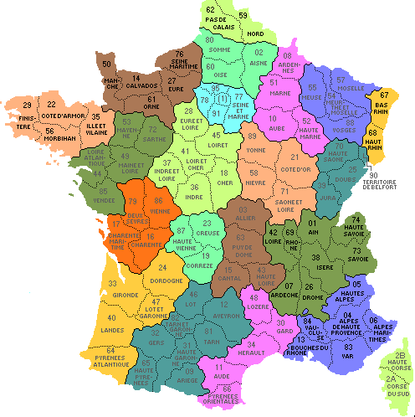
1. FRENCH LOBOUR INSPECTION : overwiew
22 DIRECCTE (+ 4 overseas region
/ 100 UT
2257 Labor Inspectors (775 LI et 1482 LOfficer)
1,82 million companies
18,21 million employees
General approch
1 LI / 8120 employees

Slide 4
2. NATIONAL POLICY OF LABOUR : role of campaigns
2.1 Priority axes of the policy of labour and the means of implementation
(PMDIT 2006):
Health and Safety at Work
OHS National Plan
risk assessment
chemical agents (CMR)
Psychosocial risks
Supervision of the market machines and
individual of protection equipments (IPE)
Campaigns

Slide 5
2. 2 Definition of the campaign
The national campaigns of inspection aim has to assure the effectiveness
of the labor law.
The action of the labour inspectorate is directed on subjects the legitimacy
of which is strong
And concentrated on a period limited (3 months).
They have an educational role, but also dissuasive towards companies potentially
offending.
AND ALSO
Develop skills of the labour inspectors in specific domains
(new regulations or particular technical subject)

Slide 6
3. RELATION BETWEEN PARTNERS AND PROCESS TO DEVELOP
THE NATIONAL CAMPAIGNS OF THE LABOR INSPECTORATE
3.1 Partners
Social partners :
Council of orientation on the working conditions (COCT)
Role of information (upstream) and action (downstream to campaigns)
OHS Institutions :
Institute of insurance of occupational accidents and professional diseases
(CNAMTS) / service of regional experts (advice and inspection companies)
National institute of research and safety at work (INRS) and
National agency of working conditions (ANACT)
- Technical support and creation of tools for companies

Slide 7
Labour Inspectors :
inspection companies (workplace)

Slide 8
3.1 Process to develop the national campaigns
CAMPAIGN PROCESS
1. Choice of the theme | - Plans OSH / cancer … - statistics data AT/MP - studies/researches INVS/ANSE -…
2. PREPARATION
2.1 Elaboration of the tools campaign | National Working group (OHS institutions / LI /DGT) - Choice of the sectors Questionnaire et note (exemple) data entry questionnaire and data base (IT tool)
2.2 Training LI | - INTEFP – conception modulates de training
2.3 Communication | SP – COCT branches / sectors general public (web site travailler-mieux.gouv.fr)

Slide 9
CAMPAIGN PROCESS
3. PREPARATION OF THE LAUNCH OF THE CAMPAIGN BY REGIONS (DIRECCTE) | SP : CRPRP et PO Institutions : CARSAT / ARACT… - Information + training campaign LI
4. INSPECTION COMPANIES | LI Technical personnel by CARSAT

Slide 10
CAMPAIGN PROCESS
5. FOLLOW UP
5.1 Promotion of results | - Outcome of campaign WG : partners (CNAMTS ….) Diffusion : Direccte / agents de contrôle PS – COCT CRPRP
 | communicates and press conference general public (web site travailler-mieux)
5.2 Consolidation of the professional practices | - Inspction tools / training
5.3 Institutional consequences | a) new regulation b) SP actions - Meeting with professional organization /branches - Working group with partners - Elaboration agreement / action plan

Slide 11
THANK YOU FOR YOUR ATTENTION

