Slide 1

Campaigns as a strategy for sustainable change : Portuguese experiences
Maria José Tiago - Portugal
Skopje, 29/30 November 2011

Slide 2

Summary
Private security sector (Oct 98/Jan 00)
Risk prevention campaign for agriculture and forestry sector (1997/1998 and 2006)
Undeclared work campaign (2011/2012)
Campaign on social responsibility of hiring networks (2011/2012)

Slide 3

Private Security Sector
(Oct 98/Jan 00)

Slide 4
Labour Activities’ Campaign: Private Security Sector
New Inspective Strategies
Rigorous identification of priorities
Dialogue with social partners about objectives and priorities
Dialogue with institutional partners (social security)
Development of proper inspective strategies
Cooperation with the media:
      “Multiplication effect”
      Population awareness
      Social values

Slide 5
Labour Activities’ Campaign: Private Security Sector
Self Regulation
Dialogue process with the sector’s partners
that leads to the resolution of problems
by the companies themselves.

Slide 6
Labour Activities’ Campaign: Private Security Sector
Methods of Self Regulation in 6 Steps
1. Better knowledge of:
      Productive processes
      Labour and commercial practices
      Subcontracting chains

Slide 7
Labour Activities’ Campaign: Private Security Sector
2. Dialogue process with social and institutional partners and other inspection systems about:
    Sector information
    Apropriate methods
    Agreement on future results
    Self regulation due date
    Beginning of inspective visits

Slide 8

Labour Activities’ Campaign: Private Security Sector
3. Public release of the objectives and self regulation due dates:
    By e-mail to the companies
    To the media

Slide 9
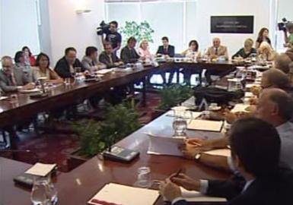
Labour Activities’ Campaign: Private Security Sector
4. Periodic meetings with the social
and institutional partners,
to evaluate progress made.

Slide 10
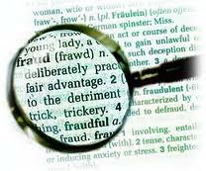

Labour Activities’ Campaign: Private Security Sector
5. After the due date, inspection visits were conducted on companies that didn’t sign for the self regulation process.
The infractions were rigorousely detected and sanctioned.

Slide 11
Labour Activities’ Campaign: Private Security Sector
6. Periodic evaluation
of the results.

Slide 12
Labour Activities’ Campaign: Private Security Sector
Quantitative evaluation of results
From Oct ‘98 to Jan ‘00
Criteria for evaluation:
      Number of employees
      Monthly Social Security contributions

Slide 13
Labour Activities’ Campaign: Private Security Sector
Entities/ Companies | Date | Number of employees | Social security contributions in $ (1€ = 200.48$)
50 | October 1998 | 19.101 | 715.469.000
50 | January 1999 | 20.361 | 757.159.000
50 | October 1999 | 20.702 | 878.609.000
50 | January 2000 | 22.768 | 974.675.000

Slide 14
Labour Activities’ Campaign: Private Security Sector

Slide 15
Labour Activities’ Campaign: Private Security Sector
Qualitative evaluation of results
Positive outcomes:
  Prevention of professional risks
  Job’s quality and quantity
  Increase of Social Security contributions
  Increase of tax payment by the companies
  Healthy competition between companies
  Social cohesion

Slide 16
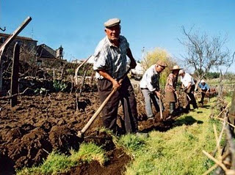
Risk prevention campaign for agriculture and forestry sector

Slide 17

Risk prevention campaign for agriculture and forestry sector
Agriculture is one of the most dangerous human activities, among the main economic activities
Health is a precious resource that must be preserved and should not be affected by accidents caused by human or mechanical failures

Slide 18
Risk prevention campaign for agriculture and forestry sector
Summary
Areas of possible intervention
Characterize the agricultural activity and its main problems
Defining priorities: what and with whom
Designing the planning of operations
Perspective the products expected
Some examples
Evaluate successes and failures

Slide 19
Risk prevention campaign for agriculture and forestry sector
WHAT IS PREVENTION OF OCCUPATIONAL RISKS?
About what | With whom
Material elements of work - Equipment and tools - Products and raw materials | - Information System - Research - Production and sale
Man | - Education system - Information System - Surveillance and health
The relationship: Man / material elements of work / social relationship inside and outside of farm | Social dialogue - Participation - Management and organization - Organization of prevention at workplace - Training System
Risk prevention campaign for agriculture and forestry sector

Slide 20
Risk prevention campaign for agriculture and forestry sector
WHAT IS AGRICULTURE?
A whole of productive activities
Agricultural production
Cattle production
Forestry production
A whole of productive activities
Polyvalent work
Productive cycles that contain work
Dispersion of the workplaces
Diversity of products, equipment and tools

Slide 21
Risk prevention campaign for agriculture and forestry sector
Agriculture…
Supposes a techical and technological support
Staff training
Advice
Research
Management strategies
And a regulatory framework
Social dialogue
Action of the state administration

Slide 22
Risk prevention campaign for agriculture and forestry sector
A Strategic Plan of Action
Clear Objectives:
Priorities corresponding to serious dysfunction
Stakeholders:
Organizations with the capacity for strategic intervention and target groups needing of a strong and specific approach
Synergy:
Development of a stakeholders relationship
able to increase each one action

Slide 23
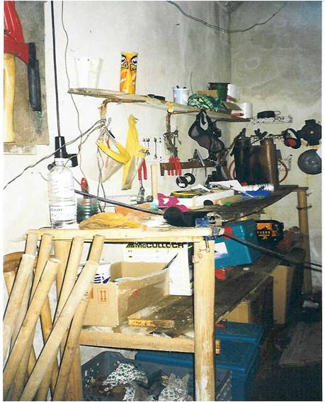
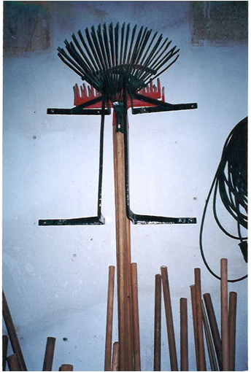
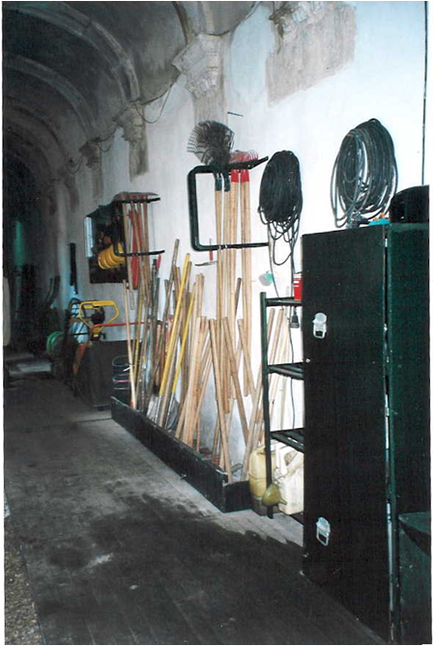

Risk prevention campaign for agriculture and forestry sector
Bad practice Good Practices

Slide 24
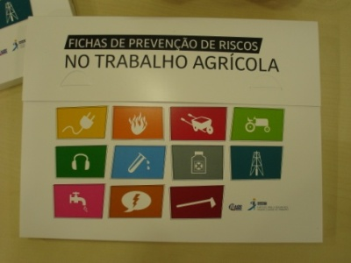
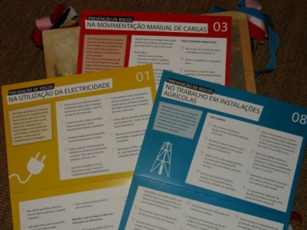
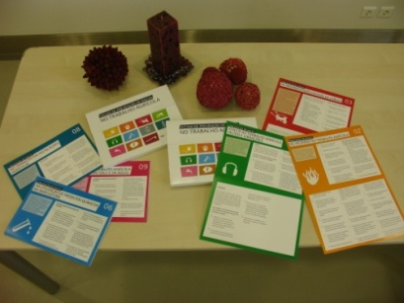
Risk prevention campaign for agriculture and forestry sector
Availability of a number of technical information tools proper to Portuguese reality
Risk Prevention Data Sheets on Farm Work
They are an informative document and sensitizer for all agricultural workers and family members, directors or employees

Slide 25



Risk prevention campaign for agriculture and forestry sector
Organized cutting of trees. Safe working
Protected cardan. Safe working

Slide 26


Risk prevention campaign for agriculture and forestry sector
Agricultural pesticid use
Organized area. Safe working

Slide 27
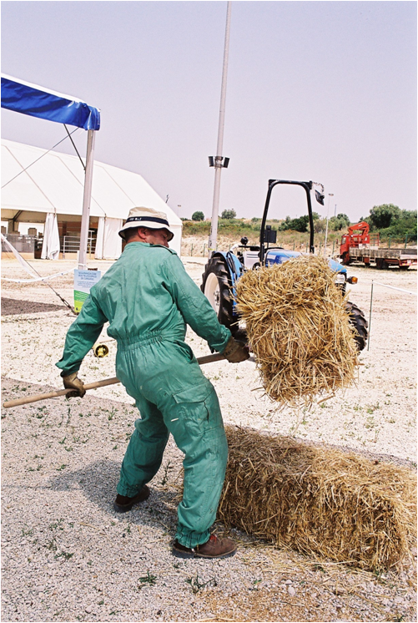
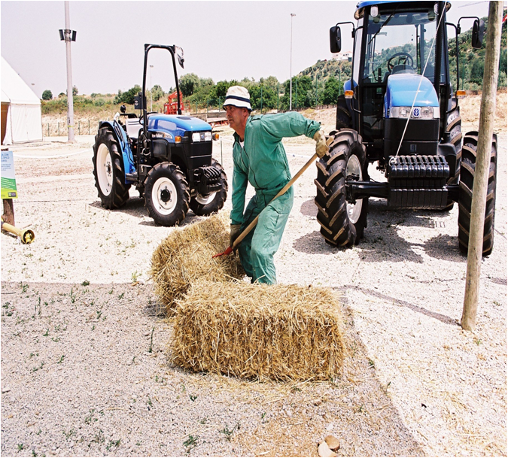
Risk prevention campaign for agriculture and forestry sector
Working demonstration in agricultural
fairs

Slide 28
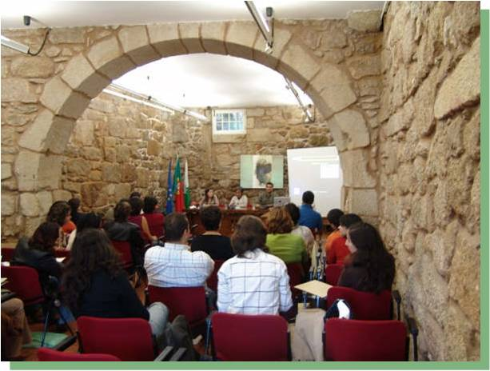
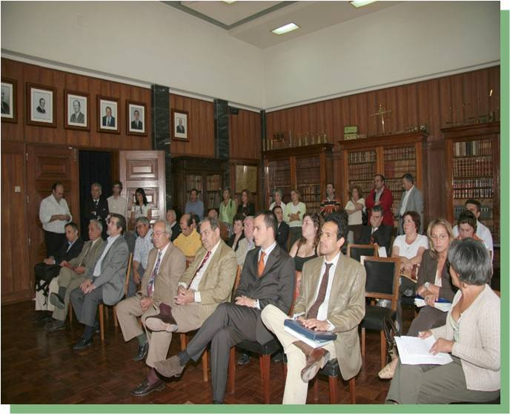
Risk prevention campaign for agriculture and forestry sector
Evaluation of the Campaign

Slide 29
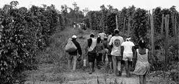
Undeclared work campaign
(2011 / 2012)

Slide 30
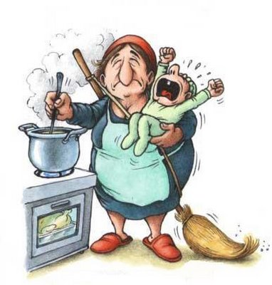
Undeclared work national campaign
Key ideas:
Decent work
Fair globalization
Work quality
Competitivity and employment

Slide 31
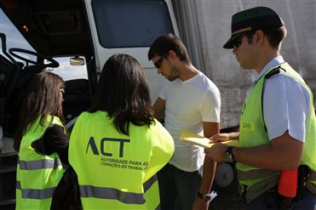
Undeclared work national campaign
Development axis and target audience
I – Awarness and information – general public
II – Education – students and working students
III – Integration and enforcement

Slide 32
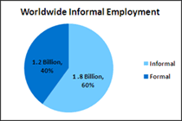
Undeclared work national campaign
Specific aims
Undeclared work of informal employers
Undeclared work of formal employers
Dissimulation of the labour contract

Slide 33
Undeclared work national campaign
Strategic aims
Improve the regulatory capacity of the administration
Contribute to increase the quantity and quality of employment
Contribute to improving the well-being at work

Slide 34
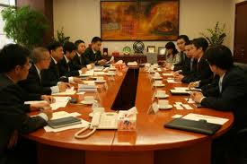
Undeclared work national campaign
Methodologies
Social dialogue and joint work
between the institutional and
social partners – creation
of working subgroups to
develop the campaign axes

Slide 35

Undeclared work national campaign
Methodologies
Subgroups functions
Develop the specific aims in order to reach the campaign’ axes regarding
- the target audience
- subjects to develop
- final products to make
- timing

Slide 36

Undeclared work national campaign
Stages of development
Identification of partners’ representatives for each subgroup (until June 2011)
Development of forms of action by subgroups
(until September 2011)
Preparation and implementations of products
Undeclared Campaign announcement and its accomplishment

Slide 37

Undeclared work national campaign
Undeclared work key words
Declared work is at a click away
Competitivity/ Employment/ Solidarity/ Sustainability
Citizenship / Social cohesion / Fundamental rights
Contributions’ increase: everybody wins, the country wins
Everybody’s contributions and your contribution may decrease
Fair competition / Transparency / Fair game
Growth
Integration / Equality

Slide 38
Undeclared work national campaign
Campaign axis: awareness and information
Products
Campaign logo
Opening seminar
Disclosure on partners’ intranet
Social communication – interviews, reports
Create a web page on a social net
Posters
Information on partner sites
Short movie

Slide 39
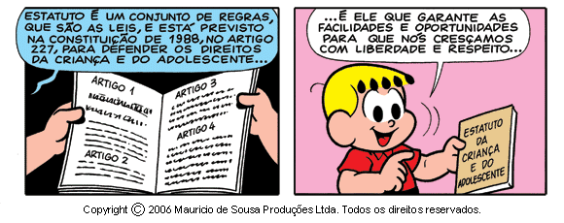
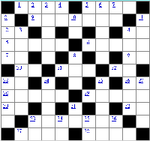
Undeclared work national campaign
Campaign axis: education
Products
Flyer / poster
Interactive game
Presentation for the students
Publication of a cartoon
Crosswords

Slide 40
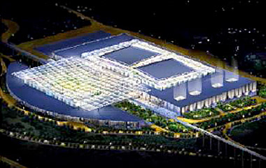
Social responsability
of hiring networks
(2011/2012)

Slide 41
Social responsibility of hiring networks
What is it?
Project 2011/2012
Proactive action by Authority for Working Conditions
Programed action of enforcement, self regulation, evaluation and divulgation
Involvement of institutional and social partners
Self regulation and its multiplier effect will contribute to the improvement in working conditions

Slide 42
Social responsibility of hiring networks
Aims
Improve the quality and quantity of employment
Collaboration and involvement of the administration of the shopping centers
In large networks hiring of shopping centers
In all support services - private security , cleaning and maintenence

Slide 43
Social responsibility of hiring networks
2. Methodologies
Better knowledge of the sector
Dialogue with the social insitutional and social partners (get consensus)
Inform the companies and management of shopping centers on the objetives to be achieved and the deadline for self regulation
Meetings and inspection action on workplaces
Evaluate results and inform the community

Slide 44

Social responsibility of hiring networks
Improvement of working conditions
Health and safety proactive
Decent and fair work
Increasing motivation
Social responsability
Promotion of employers’ rights

Slide 45
Social responsibility of hiring networks
Key role of labour inspectors
Social dialogue
Employers and employees’ obligations
Healthy and safe work
Decent work

Slide 46
Thank you for your kind attention
Maria José Tiago

