Slide 1
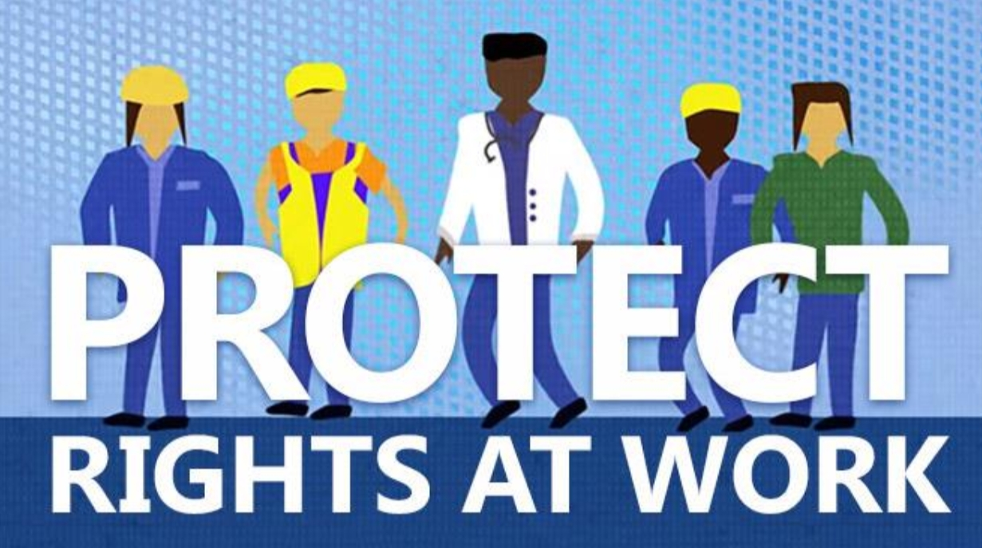

Towards more effective labour protection for all workers
  Martha Newton, Deputy Director-General for Policy, ILO
  Mark Keese, Head of Skills and Employability, OECD

Slide 2

Outline of the presentation
Labour protection: what it is and why it is important
Trends and policy responses concerning labour protection during the pandemic
    Wages
    Working time, work organization
    Occupational safety and health
    Informal work
    Platform workers
    Policy implications

Slide 3

Labour protection: what it is and why it is important
Three determinants
    Coverage
    Level
    Compliance
Employment protection
Fundamental Principles and Rights at Work
Wages
Occupational Safety and health
Working time

Slide 4
Trends and policy responses during the pandemic - Wages
    Trends
    In the first half of 2020, some countries experienced a downward pressure on average wages growth rate, while others felt an increase due to “composition effect”
    Women’s wages have been disproportionately affected
    Policy responses
    Temporary job retention schemes to promote retention of workers and offset impact of working-time reductions on income
    Adjustments to minimum wages to support low-paid workers
    Collective agreements to tailor solutions to the situation of specific sectors or companies

Slide 5
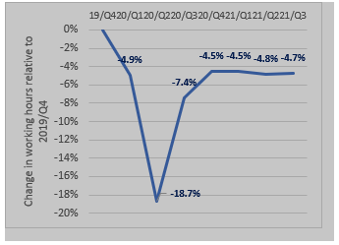
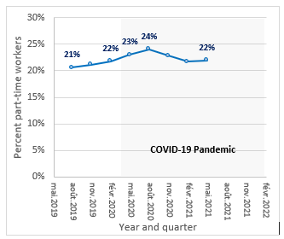
Trends and policy responses during the pandemic - Working time, work organization
Working hours losses relative to Q4/2019
Percentage of workers working less than 35 hours/week
Source: ILO Covid Monitor, 8th Edition
Source: Labour force and other household surveys microdata
Notes:
Acceleration in the use of teleworking to attempt to limit the spread of COVID-19 virus
Many jobs and businesses were saved, but a number of risks amplified
A wave of legal and policy reforms, including regarding the "right to disconnect", in a number of G20 countries
Interplay between sectoral and enterprise-level bargaining to negotiate adequate responses on working time and

Slide 6
Trends and policy responses during the pandemic - Occupational Safety and Health
    Trends
    Uneven impact on workers’ health and safety
    Some were particularly affected due to:
    their profession, e.g. healthcare
    increased risk due to closeness during work interactions
    shared accommodations
    public transport
    Policy responses
    A renewed spotlight on OSH
    Enhanced collaboration between public health and occupational safety and health authorities
    New risks, e.g. mental stress, violence and harassment arose with measures put in place to slow the spread of the virus
    Enhanced social dialogue and cooperation at the national, sectoral and enterprise levels resulted in better tailored solutions

Slide 7
Trends and policy responses during the pandemic - Informal work
    Trends
    In the early stages of the pandemic, informal employees were three times more likely than formal employees to lose their jobs; but in subsequent stages, informal self-employment has rebounded faster in some G20 countries
    Informal women workers have been the hardest hit in terms of job losses
    Workers with temporary employment contracts were also hit disproportionately harder than those with open-ended and full-time contracts
Policy responses
    Inclusive strategies to identify and register groups eligible to public support, independently of their formal or informal status
    Use of existing identification, registration and delivery mechanisms for a rapid roll-out of benefits
    Partnerships with associations of informal workers
Notes:
combination of three ongoing transitions: the return of many informal workers to their economic activities; new entrants, previously outside the labour force, entering informal employment, often as casual workers, own-account workers or unpaid family workers, to compensate for losses in household income; and the informalization of previously formal jobs.

Slide 8
Trends and policy responses concerning labour protection during the pandemic - Platform workers
    Trends
    In the context of a trend rise in platform work, the pandemic had a differentiated impact on platform workers
    Some on-location platform workers were exposed to both a loss of earnings and an elevated risk of contagion.
    At the same time, many faced lower levels of access to social protection
Policy responses
    Several G20 governments took unprecedented steps to protect the self-employed and platform workers
    This included extending social protection coverage to the self-employed as well as providing universal cash payments.
    Some platform companies also took measures to protect the health and the incomes of workers using their platforms
Notes:
combination of three ongoing transitions: the return of many informal workers to their economic activities; new entrants, previously outside the labour force, entering informal employment, often as casual workers, own-account workers or unpaid family workers, to compensate for losses in household income; and the informalization of previously formal jobs.

Slide 9
Policy implications
    To reduce inequalities across workers and strengthen resilience in the face of new crises, labour protection needs to be inclusive, adequate and effective.
    Use all levers of labour protection and take into account coverage, level and compliance
    Key role of social dialogue, including with public health and OSH authorities
    Transform temporary emergency measures into sustainable mechanisms to close protection gaps
    Generate sufficient formal employment to absorb rebound in labour force and prevent any risk of increased informalisation
    Tackle labour market duality between permanent and temporary employment
Notes:
combination of three ongoing transitions: the return of many informal workers to their economic activities; new entrants, previously outside the labour force, entering informal employment, often as casual workers, own-account workers or unpaid family workers, to compensate for losses in household income; and the informalization of previously formal jobs.

