Slide 1

PROGRESS REPORT
Bilbao, 7 May 2010

Slide 2
Updated information

Slide 3



a mascot was created (CHEMY)
Information is based in traditional materials
    8 posters
    general flyer about the campaign and on risk assessment
    4 brochures
a website (http://www.chemicalscampaign.eu)

Slide 4
The posters

Slide 5
GENERAL POSTER
Messages intend to claim the
attention of both the employer
and the workers
Slogan
Prevention principles
Importance of labels and
safety data sheets

Slide 6
Sectoral posters
Slogan
Demonstration of good practices
the most relevant features
are shown in a different
colour
the mascot always addressing a safety advice

Slide 10
Information brochures

Slide 11

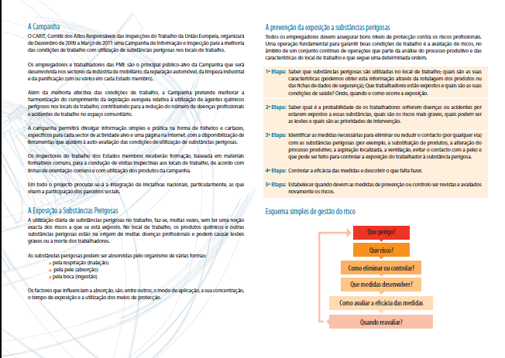
General flyer

Slide 12

Common structure of the brochures

Slide 13
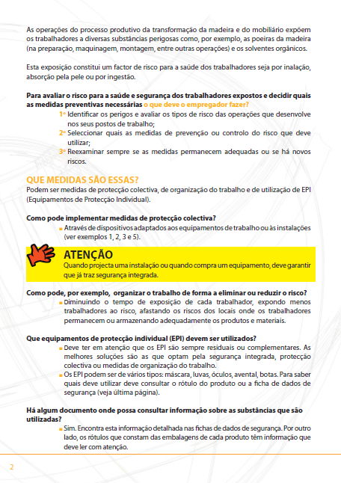
Questions and answers
(clear and simple)
Main ideas on colour boxes

Slide 14
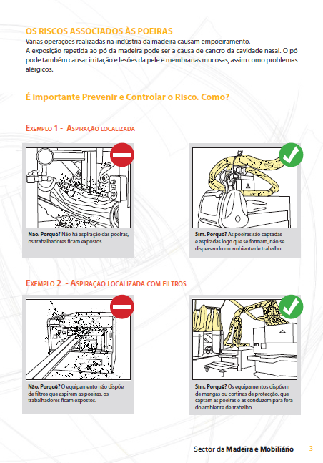
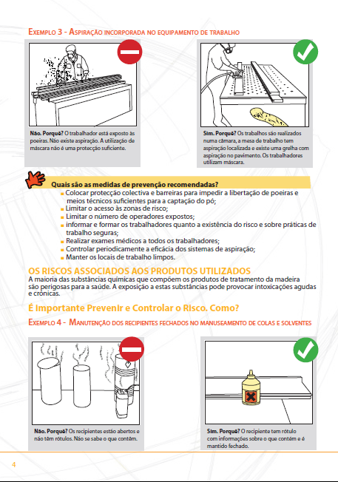

Slide 15
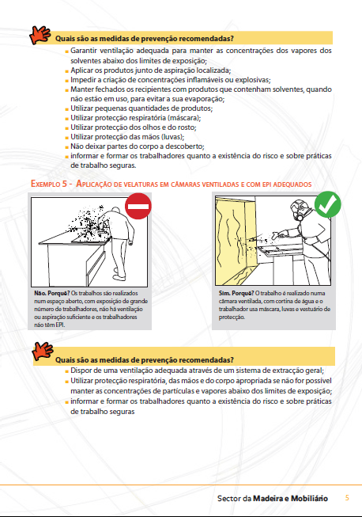
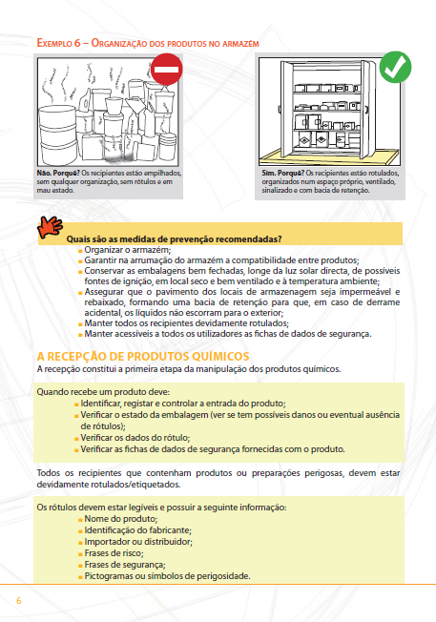

Slide 16
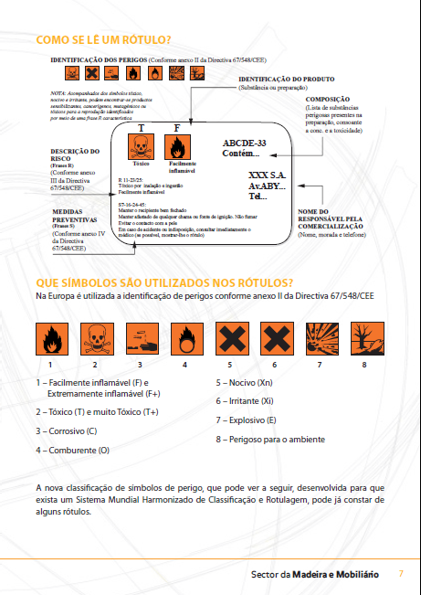
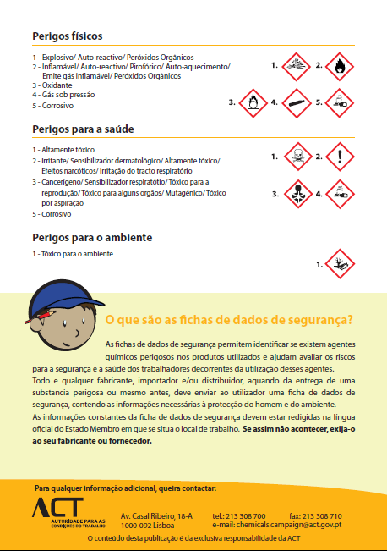

Slide 17

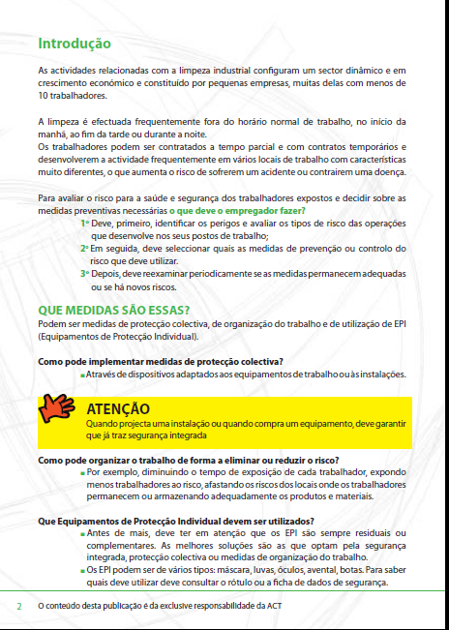
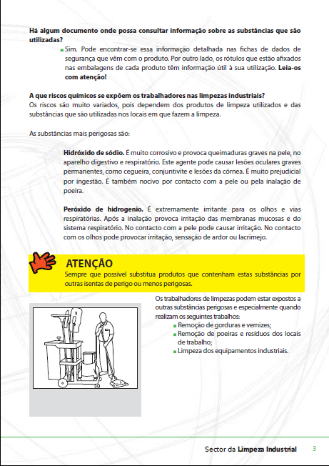
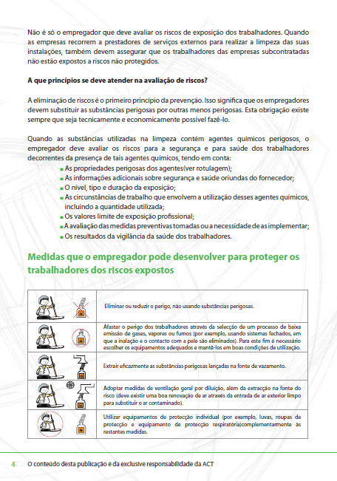
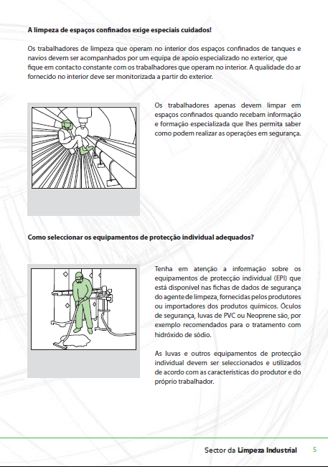
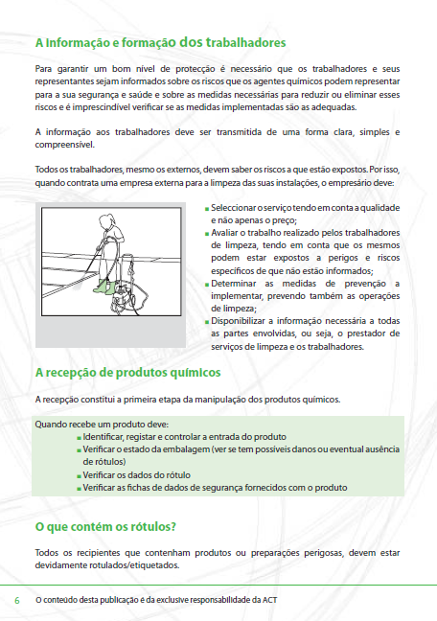
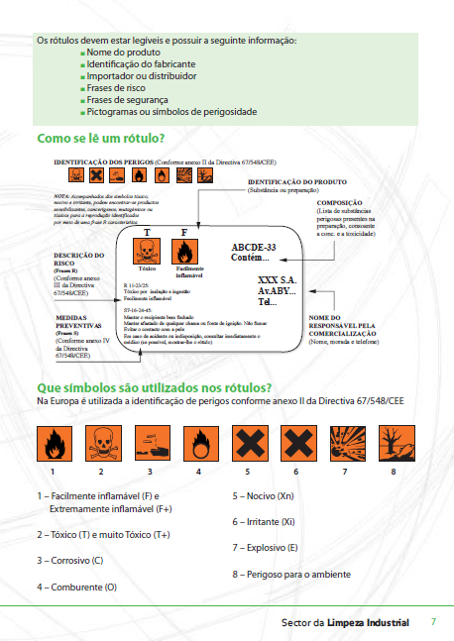


Slide 18
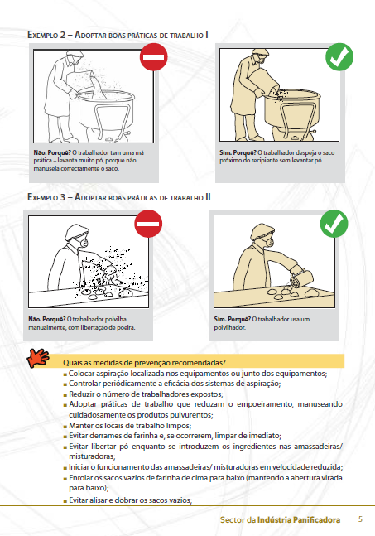
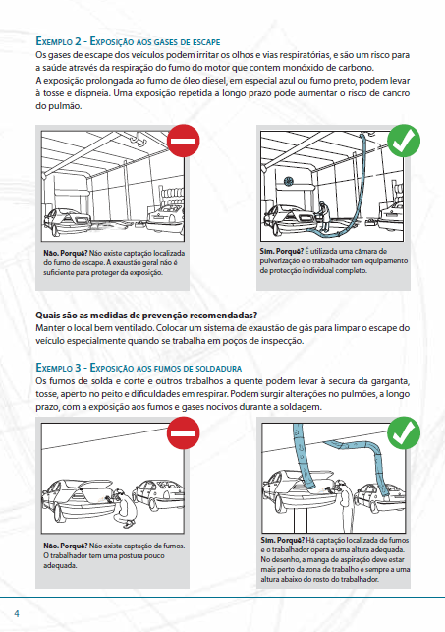
(MVR)
(Bakeries)

Slide 19
The website

Slide 20
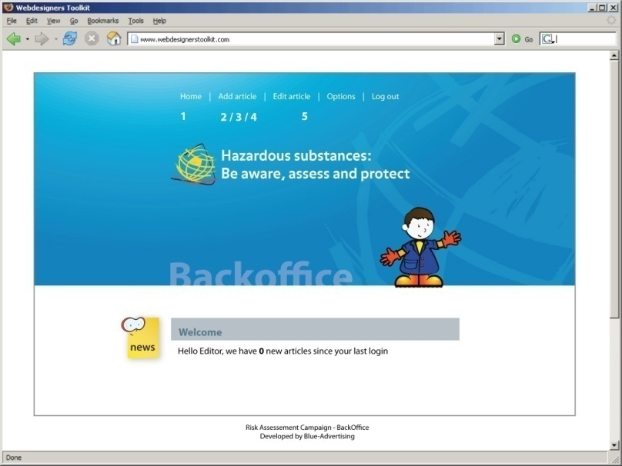
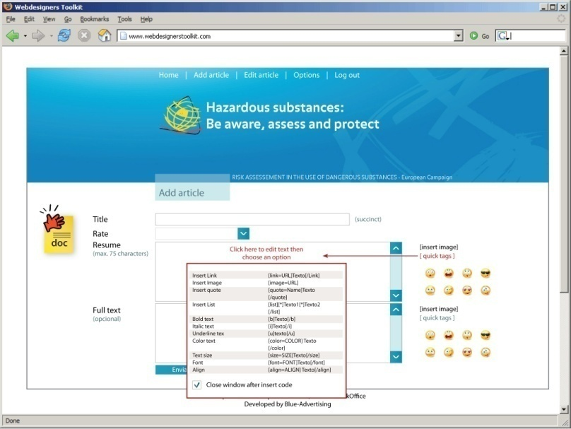
Official site in English
Languages of all MS except Italian
Administrator: PT
National focal points required to upload
some areas (agenda, legislation, events)

Slide 21
TRAINING WORKSHOP
Luxembourg, 28th April 2010

Slide 22
Main objectives of the training:
To identify the general principles and guidelines of the European
Campaign of Risk Assessment in the Use of Dangerous Substances
To develop training skills with the use of the available instruments for
the campaign
To identify hazardous substances and preventive measures in :
    Cleaning activities
    Bakeries
    Furniture production
    Motor vehicle repair

Slide 23
9H00 | Opening: Information on the Campaign | J. Pintado Nunes Portugal
9H30 | European Legal Framework on Dangerous Substances | Fátima Pisco Portugal
10H00 | Coffee-break
10H15 | Website and E-learning Platform: recommend instrument | José Pechirra Portugal
11H00 | Coffe-break
11H15 | Dry Cleaning and Industrial Cleaning | Daniela Geceslovka Slovakia
12H30 | Lunch

Slide 24
14H00 | Bakeries | Gareth Doran Ireland
15H00 | Coffe-break
15H15 | Wood transformation and Furniture | Cristiano Oneto João Tavares Portugal
16H30 | Coffee-break
16H45 | Motor Vehicle Repair | Peter Woolgar UK
18H00 | Final remarks and end of session | J. Pintado Nunes

Slide 25
Recommended training

Slide 26
THE PROJECT LEADER RECOMMENDS MS TO:
use the e-learning platform
develop national training in accordance with the “training the trainer”
workshop in Luxembourg
WHY:
Through e-learning more labour inspectors can be trained (at distance, although
some presencial sessions are required)
It allows gains in efficiency (labour inspectors can access the platform whenever
they want / Inspectorates can cut costs in travels, vehicles,
paper, training rooms...)
Some LI can get acquainted with new technologies in training

Slide 27
Member States which opt for distance learning are recommended to organise the training as follows:
One session attended by the trainees in person in which they are briefly introduced to the contents of the training course
A period of distance training during which trainees have access to the educational materials available on the platform and can interact with trainers through discussion forums or simply by asking questions
A final assessment period in which the level of success of the training is evaluated.

Slide 28
The course contents should be structured into modules
The course is preceded by what may be termed a pre-sessional module or Module 0
Example:
Pre-sessional module | Module 0 | Online familiarisation and socialisation
Training | Module 1 | The production cycle in the wood and furniture industry
 | Module 2 | Specific risks involving the use of hazardous substances
 | Module 3 | The legal framework
 | Module 4 | Inspection methods and instruments

Slide 29
Example of Training sessions
Module 2 – Specific risks involving the use of hazardous substances
- Identification of the characteristics of hazardous substances and their effects on human health: Wood dust, solvents (toluenes, xylenes, methanol), paint, glue and varnish (isocyanates and formaldehyde), preservers (copper and chrome metal salts).
- Identification of techniques for the prevention of exposure to hazardous chemical agents, in accordance with general prevention principlesInformation, training and consultation of workers and their representatives.
- Individual protective measures and equipment
- Accidents, incidents and emergency situations
- Health surveillance

Slide 30
Example of Training sessions
Module 3 – The legal framework
  EU directives
  National legislation
Module 4 – Inspection methods and instruments
- Methods within the European Campaign: the preparatory questionnaire
- Instruments for enforcement
- Evaluation

Slide 31
The technical and pedagogical resources used on the course can comprise:
- Basic texts on each topic available online for downloading
- Video recordings on specific health and safety topics
- Multimedia PowerPoint presentations designed by the trainer(s)-tutor(s) for specific learning situations
- A tutorial on how to use the Moodle platform in a learning context (provided by the project leader)
- A course guide
Inspection instruments
(...)

Slide 32

Trainees must meet all of the following requirements:
- IT user skills in a Windows environment
- Experience in using web browsers, in particular Microsoft Internet Explorer (IE)
- An active email account and some experience of using it
Availability to:
Participate in discussion forums
Study the contents provided online on a self-access basis
Complete the set tasks
Complete an assessment questionnaire.

Slide 33
What is expected from national platform managers:
Develop and submit the national training module to the National Directorates of Labour Inspectorates
Report to the project leader if the Member State opts for distance training
Use the educational materials provided by the leader and the working party
Develop specific training materials
Manage the platform for the Member State autonomously, notwithstanding any support that may be provided by the project leader.

Slide 34
What is expected from trainer(s)-tutor(s):
Be available to trainees in order to supervise and support them throughout the course
Access the course IT platform at least once a day during the training period in order to reply to messages sent by trainees or, on their own initative, to ask questions and/or give information to trainees
Provide phased proactive and ongoing contributions via discussion forums and emails
Reply to questions or queries presented by trainees within 24 hours (one working day).

Slide 35
Guidelines for enforcement

Slide 36
From 15 September to 31 December 2010
Information materials (posters/ brochures) can be used during inspection visits
(recommended)
No binding method, although the previous approach of employers through a
questionnaire distributed by labour inspectorates is welcome, according
with the model provided by the project leader
MS will be asked on quantitative goals (number of workplaces to visit and labour inspectors involved)
All visits are expected to consider a minimum set of dangerous substances
(see indicator maps)
Support instruments will be provided (again in a voluntary basis): check-lists
for labour inspectors, documents available ion the website and training materials
It is expected that MS give feedback in order to allow the Campaign’s
evaluation, by sending the evaluation sheets to the project leader in late January 2011

Slide 37
Recommended method (non binding)
LI adapts the Questionnaire
Questionnaire sent to selected companies, with an official letter
Companies requested to send back answers
Analysis of questionnaire
Selection of companies to visit, according with the analysis
Visits

Slide 38
How does it work? (PT example)
ACT develops the questionnaire
Identification of companies through LI databases (sample)
Local inspectorates receive instructions on how to use the instrument
Questionnaires are sent by local inspectorates with an official letter (end of May)
Answers requested from companies till 15 July
15 July to
31 August:
LI analyse
answers
Questionnaire is sent in a pack
with:
official letter
flyer on risk assessment
informative brochure for the
sector

Slide 39
How does it work? (PT example)
ACT develops the questionnaire
Identification of companies through LI databases (sample)
Local inspectorates receive instructions on how to use the instrument
Questionnaires are sent by local inspectorates with an official letter (end of May)
Answers requested from companies till 15 July
METHOD TO SELECT COMPANIES
TO VISIT:
Companies that did not answer the
questionnaire, but received it
Answers showing the company is lacking
common knowledge on risk assessment
Ramdomly
Visits are not expected to more than 20% of
the sample
Selection criteria informed to companies in the
official letter

Slide 40
How does it work? (PT example)
ACT develops the questionnaire
Identification of companies through LI databases (sample)
Local inspectorates receive instructions on how to use the instrument
Questionnaires are sent by local inspectorates with an official letter (end of May)
Answers requested from companies till 15 July
WHAT WE EXPECT FROM THIS:
small companies will be faced with the need
to collect data on risk assessment
it can play the role of a “trigger” in companies
unwilling to comply with OSH regulations
(it has to be clear in the official letter that
control visits will be made in the near future)
It can play a multiplier effect
It is a preventive approach (companies are
expected to act accordingly with legal requirements)
It can also provide important data to LI to
update databases

Slide 41
How does it work? (PT example)
ACT develops the questionnaire
Identification of companies through LI databases (sample)
Local inspectorates receive instructions on how to use the instrument
Questionnaires are sent by local inspectorates with an official letter (end of May)
Answers requested from companies till 15 July
WHAT WILL THE PROJECT LEADER
PROVIDE:
Questionnaire for companies
Example of official letter
Small support manual
WHAT IS EXPECTED FROM NATIONAL PROJECT
MANAGERS OF MS WILLING TO ADOPT THIS
METHOD:
To adapt the questionnaire and official letter to
national realities

Slide 42
Indicators of Communication and Information

Slide 43
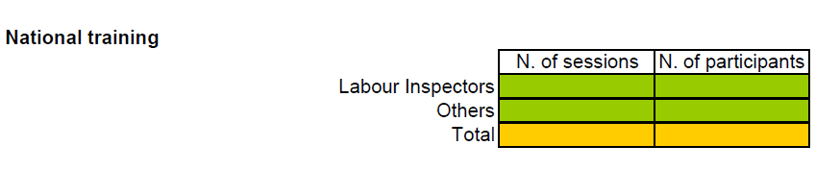
Information materials (distributed/ downloaded)
 | Member State
 | Sector
 | N. of leaflets
 | N. of posters
Seminars, workshops and other information events
 |  | N. of events | N. of participants
 | Total
 | In schools

Slide 44
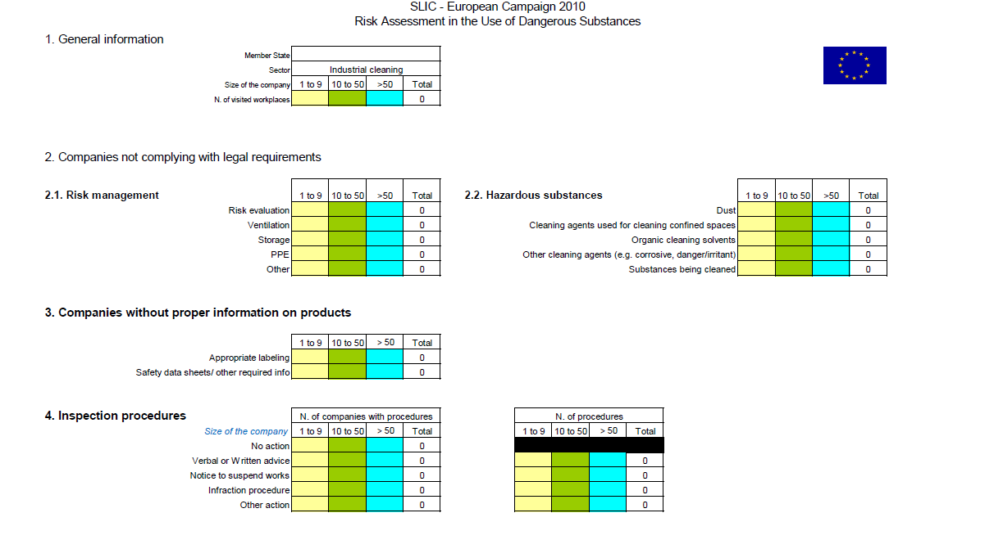

Slide 45
Sectoral indicators
Dry cleaning
- Perchloethylene
(Tetrachloethylene)
- Other clothes cleaning agent
- Surfactors
- Organic solvents
- Other cleaning agents
Industrial cleaning
- Acids
- Hypochlorites
- Ammoniac
- Hydroxides
Furniture
- Wood dust
- Solvents
- Paints, glues, varnishes
- Preservatives
MVR
- Paints with isocyanets
- Other respiratory risks (dusts, fumes and gases)
- Skin risks (e.e. oils and solvents)
Bakeries
- Flour dust
- Liquid ingredients
- Cleaning agents

Slide 46
Early May – Translation of all information
materials into national languages
May/ July – Launching of the website
(Official and national)
June / July – National training
15 September/ 31 December: Enforcement
31 January 2011 – Evaluation (MS requested to send indicators maps)
3 March 2011 – Closing up seminar (Lisbon)

