Slide 1
Benchmarking exercise bricklaying, plastering, masonry & sewing machine operation
12-14 June 2019
Yangon, Myanmar

Slide 2
National MRS Workshop Benchmarking exercise between Myanmar and Thailand, 12-14 June 2019

Slide 3
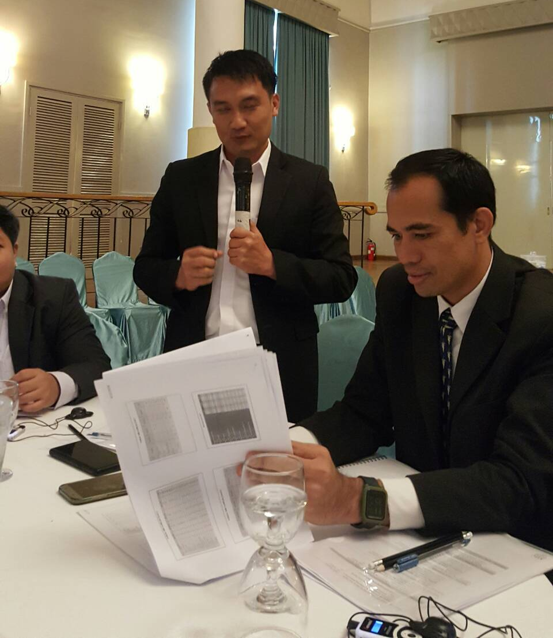
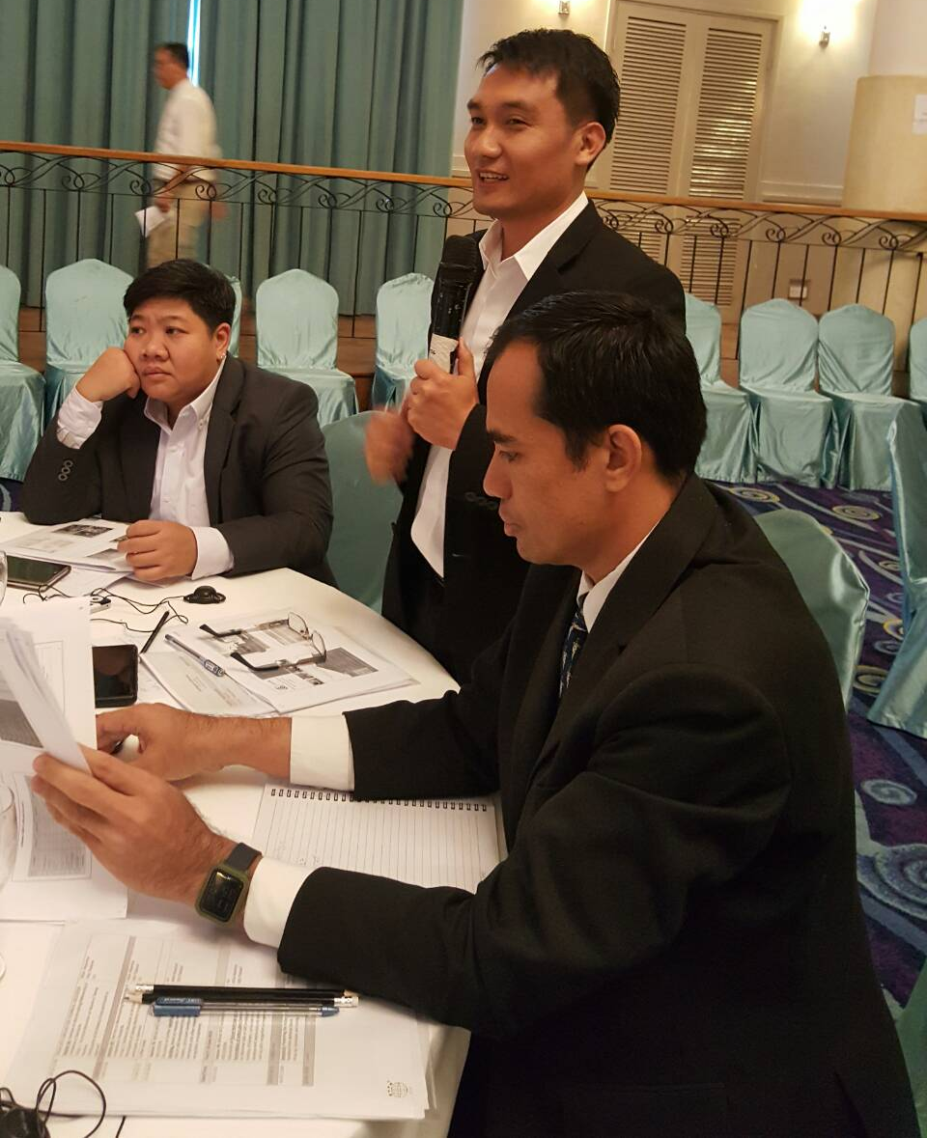
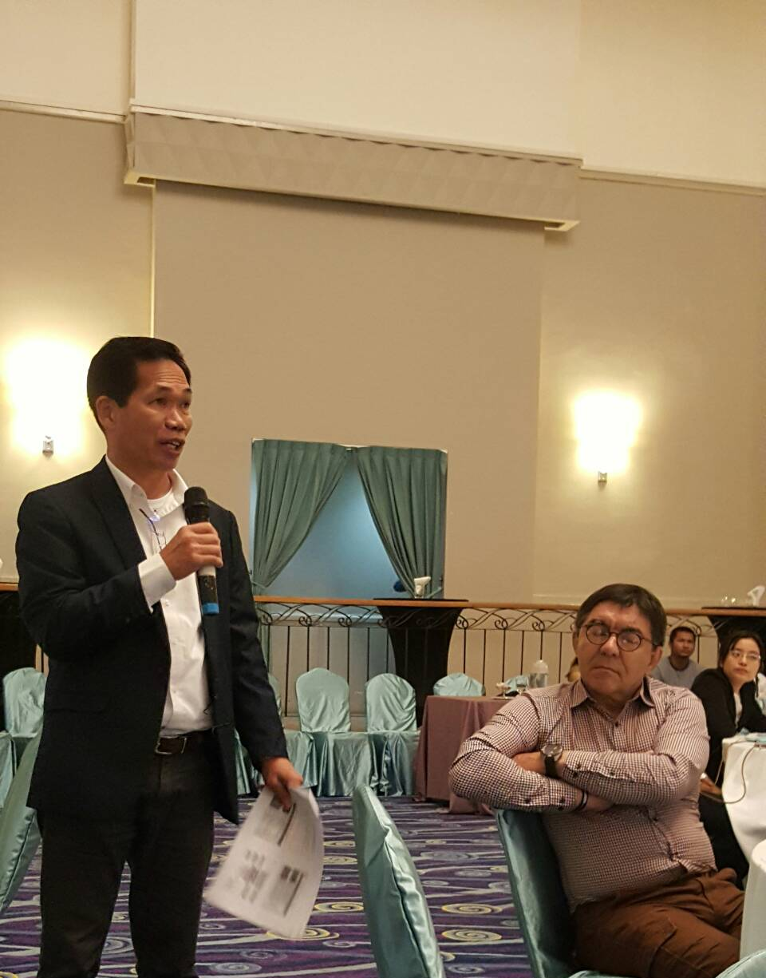
Plenary – 12 june 2019

Slide 4
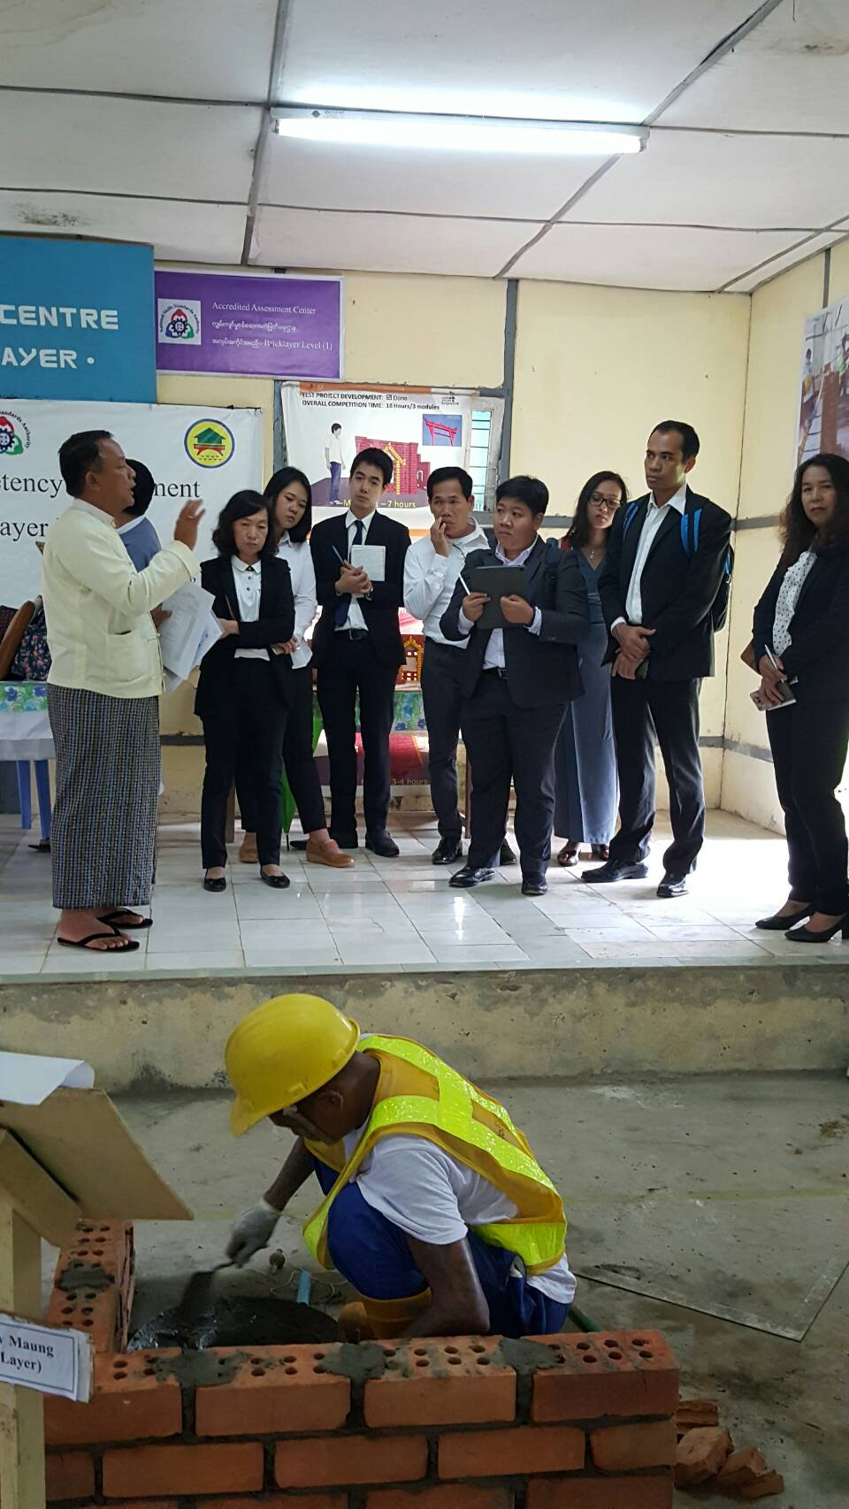
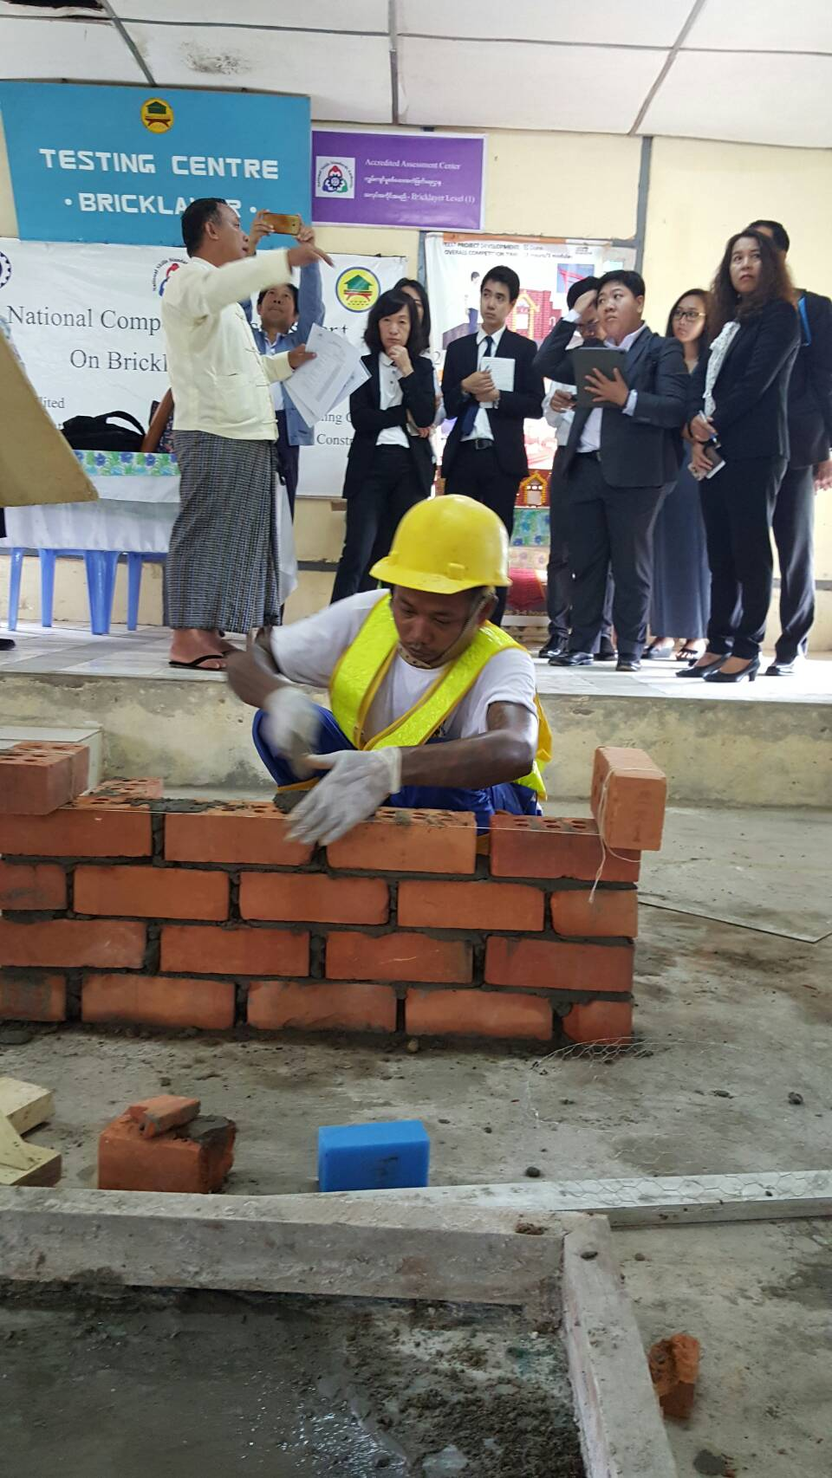
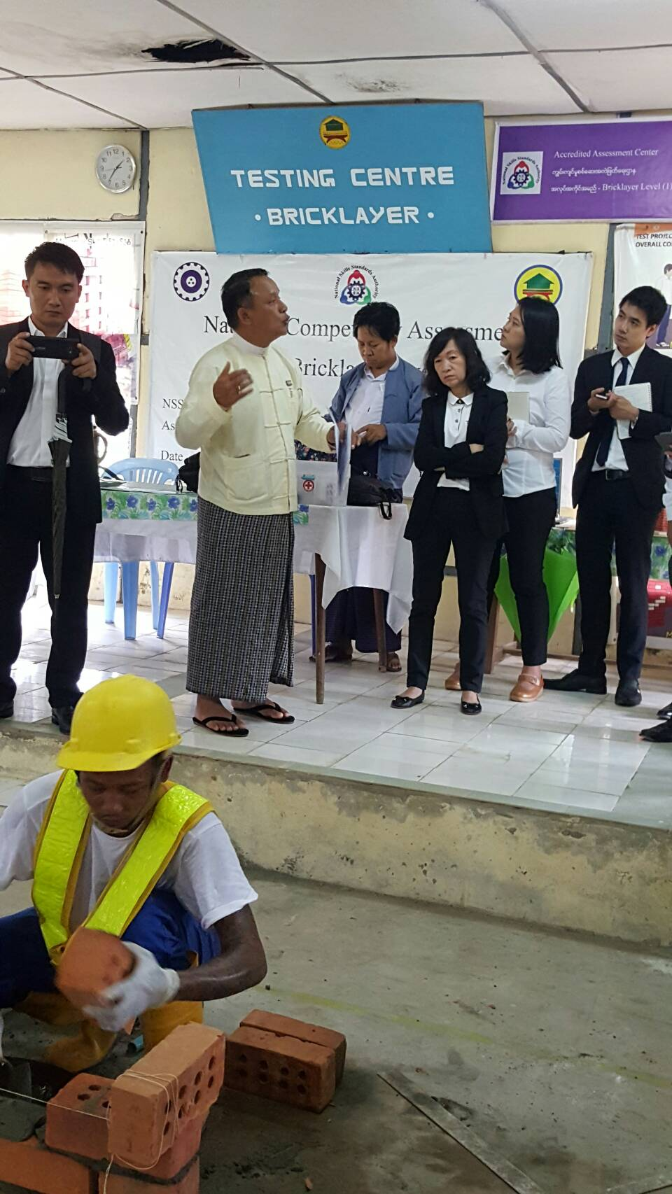
Bricklaying, masonry, plastering workshop – June 2019

Slide 5
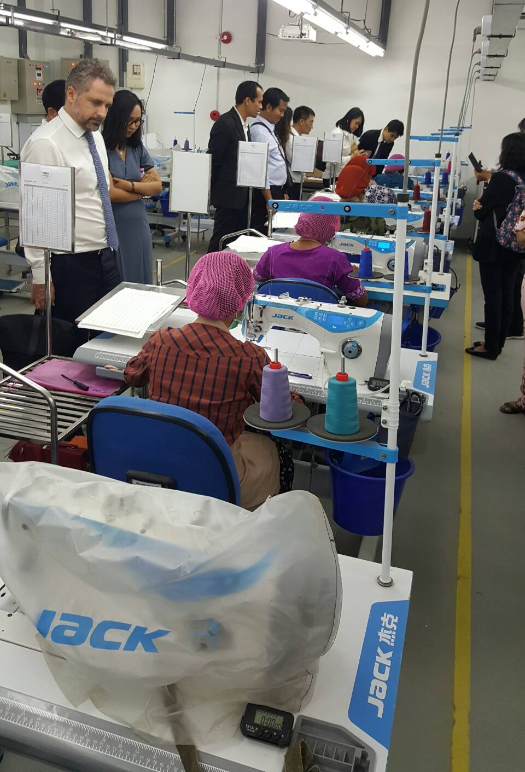
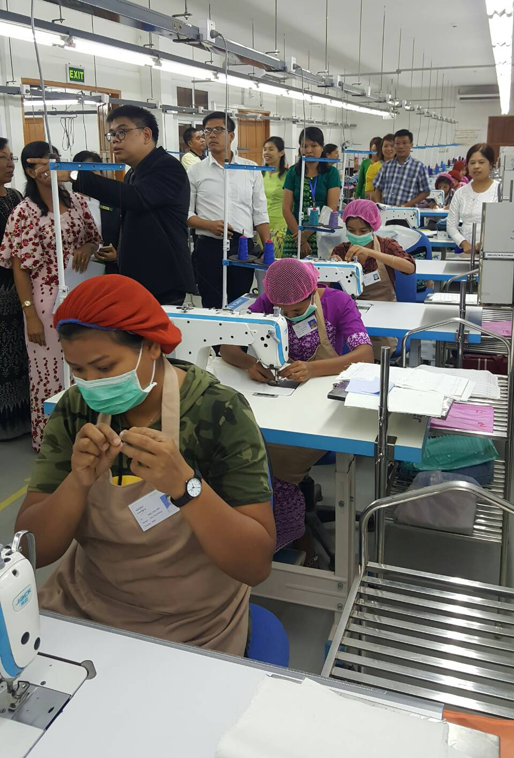
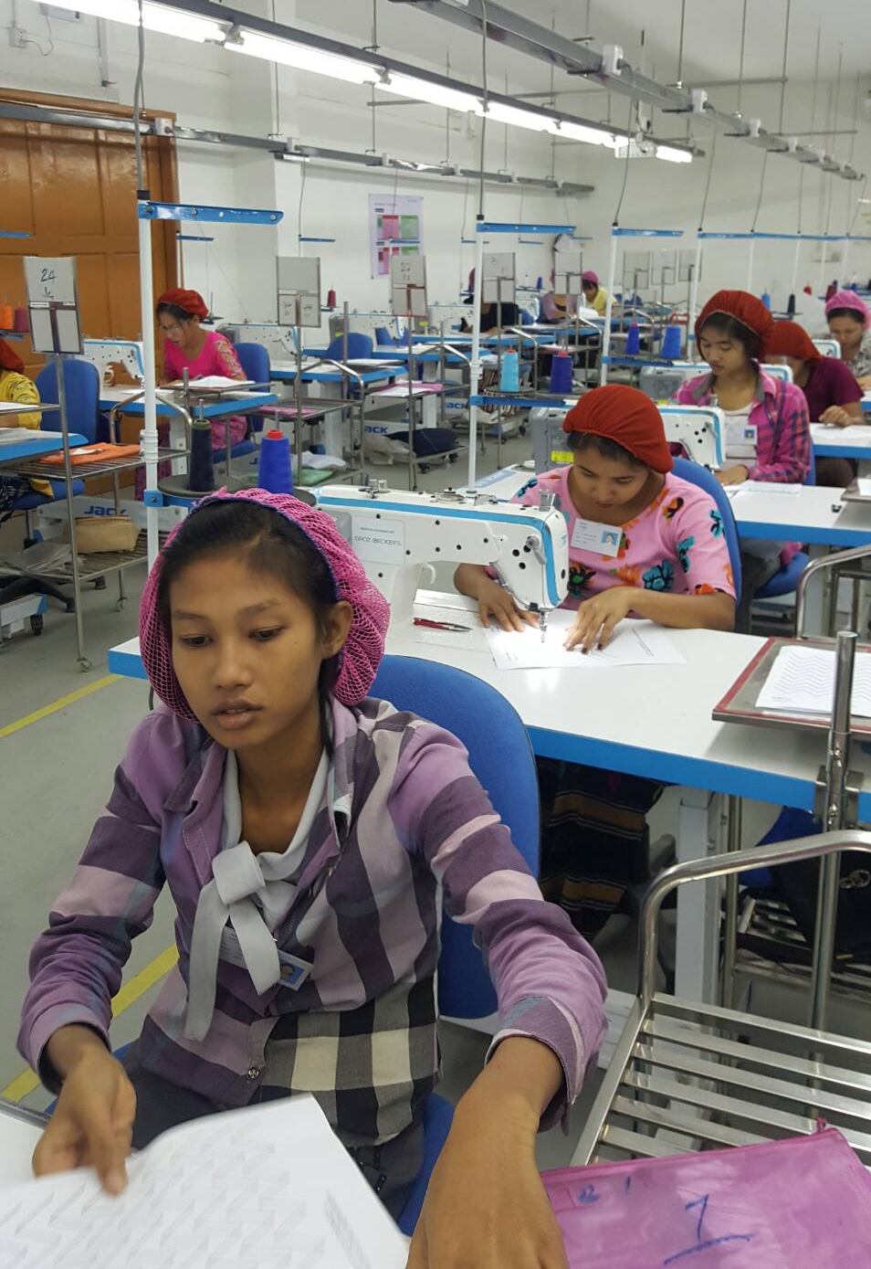
Sewing machine operation workshop – june 2019

