Slide 1
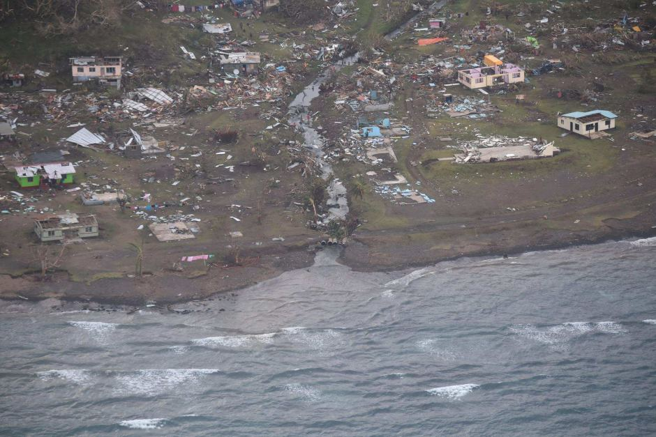
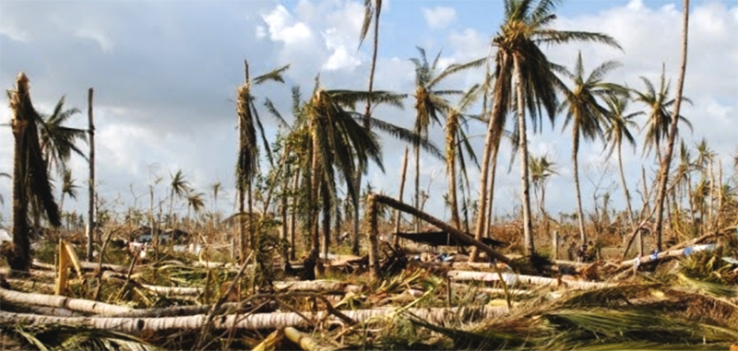
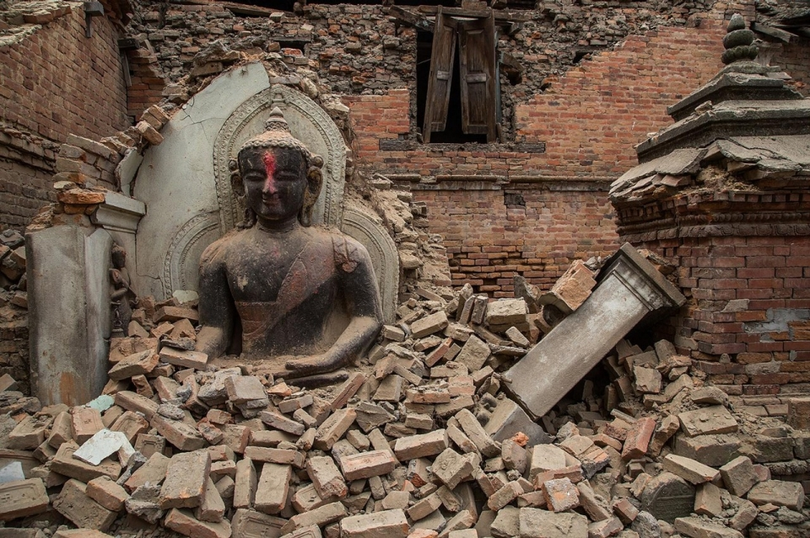
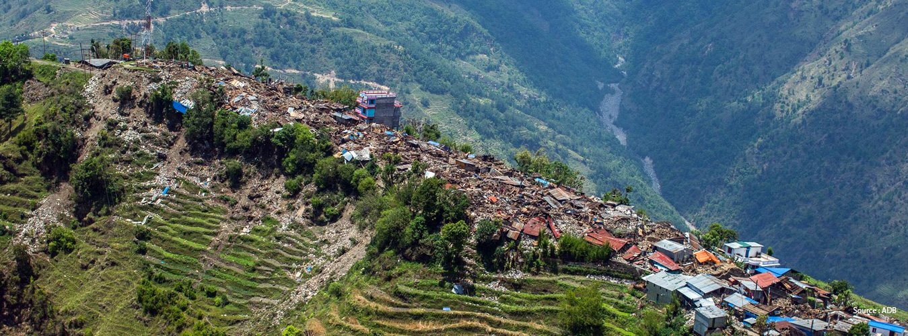
The Post-Disaster Needs Assessment (PDNA)
Notes:
Copyright by Getty Images

Slide 2
Government-led exercise that produces a single consolidated assessment report
Global mechanism that collects information on economic damages and losses, and generates recovery framework with a BBB & human-centered approach
Coordinated and coherent approach based upon the EU-UN-World Bank Joint Declaration on Post Crisis Assessments and Recovery in 2008
What is the PDNA?
→ Video

Slide 3
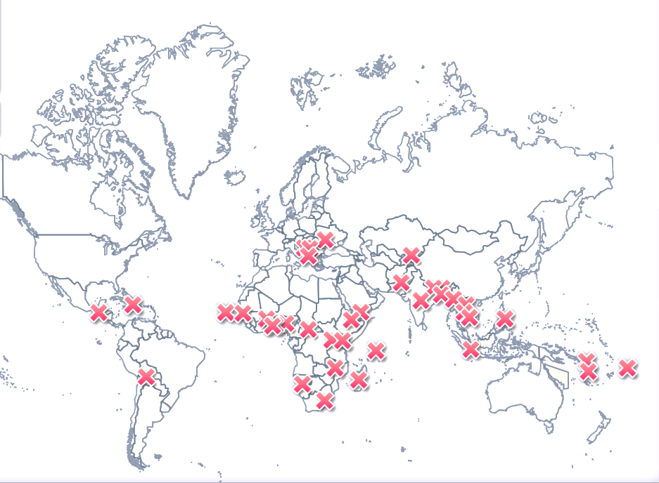
Since 2005
48 PDNAs have been conducted in 40 countries
The ILO has supported 27 assessments
Out of these six were conducted in the last 12 months
Notes:
See: http://www.gfdrr.org/sites/gfdrr/files/urban-floods/PDNA.html

Slide 4
The Assessment Process
Step 2 collection of post disaster information: - secondary data from PDNA sectors - primary data through field visits
RECOVERY
ASSESSMENT
HAZARD
Steps 3 estimation of the disaster effect: - quantitiative
Steps 4 analysis of the disaster impact: - qualitative
Steps 5 identification of recovery needs and formulation of recovery strategy: - quantitative - qualitative
Step 1 collection of pre-disaster information:
- Constructing the baseline through desk research

Slide 5
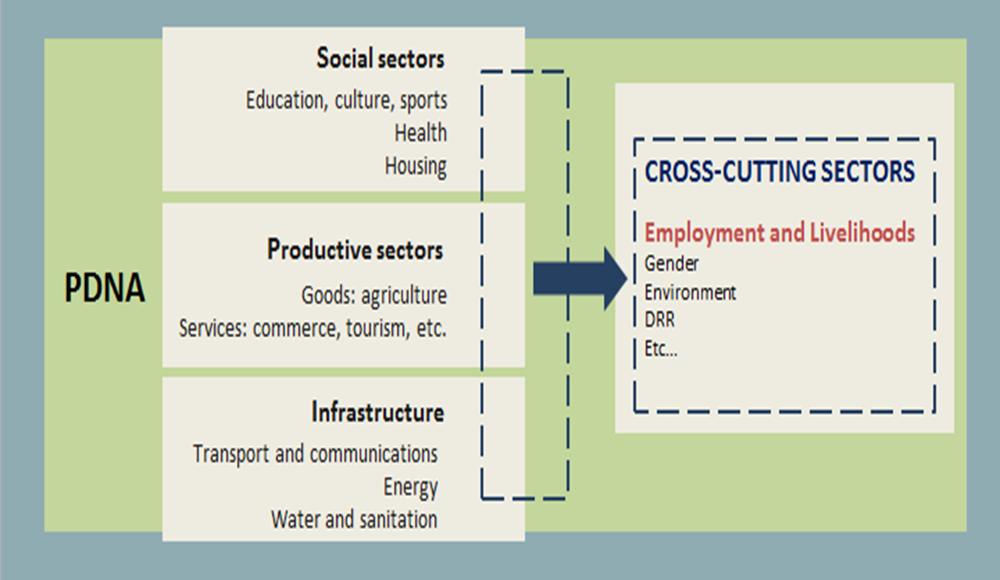
Facilitation of Employment, Livelihoods & Social Protection Sector Assessment
Quantitative analysis to estimate the lost work days and lost personal income
Qualitative analysis to contextualize the quantitative findings → what’s the disaster’s impact on i.e. people with disabilities, female-headed households, elderly, informal workers and unemployed people and people with HIV/Aids?
Identification of EL&SP recovery needs
What does the ILO do in a PDNA?

Slide 6
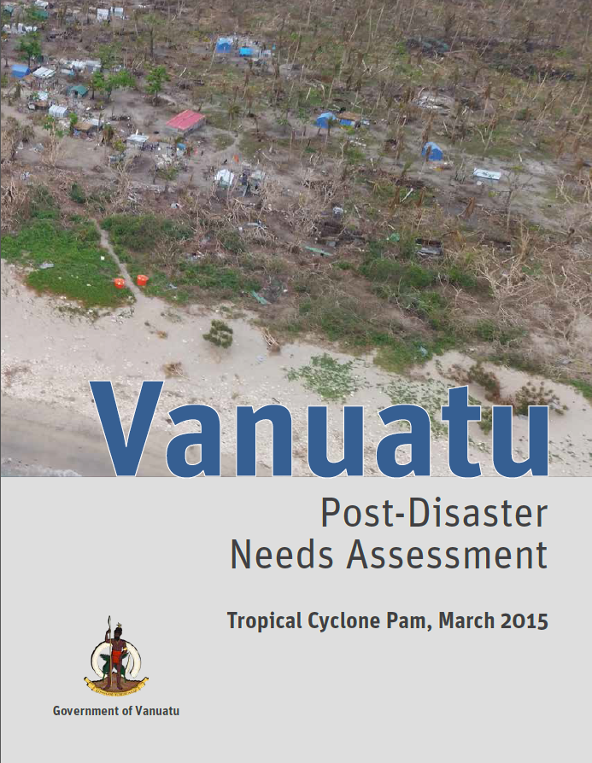
Vanuatu: rapid summary
US$449.4 million of damage and losses
equivalent to 64.1% of GDP
40,000 households affected
504,050 lost work days
US$14 million lost personal income
cost for recovery and reconstruction US$316 million

Slide 7
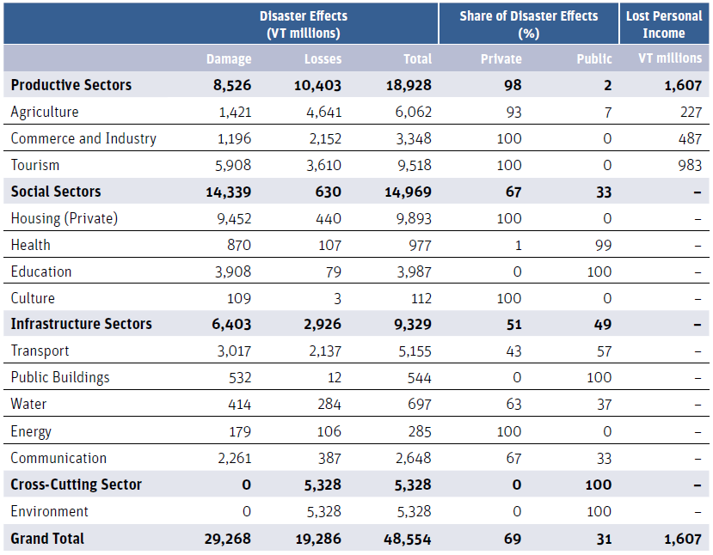
Vanuatu: Innovations - an easy way to avoid double counting
Every PDNA report includes a summary table that captures the Damages and Losses per Sector.
The lost personal income should be included in a seperate column to reflect the cross-cutting nature of the Employment and Livelihoods Sector and to avoid double counting of losses.
Notes:
Example from 2015 Vanuatu PDNA

Slide 8
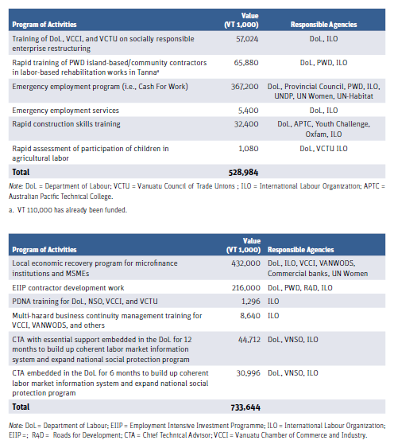
Recovery needs defined by Short, Medium and Long-term…

Slide 9
Vanuatu and Nepal compared: response strategy & activities
Vanuatu
Nepal
Small (3) CO Suva (1)
HQ GVA (1) Int Consultant (1)
NO REGULAR PRESENCE
Large (22) CO KTM (14)
DWT Delhi (4) ROAP (2) HQ GVA (1) Int Consultant (1)
ILO presence on the ground
Constituents & civil society Department of Labour VN Chamber of Commerce and Industry VN Council of Trade Unions
VANWOODS Microfinance
Int partners & constituents UN agencies, EU, World Bank, ADB, JICA
National Planning Comission Ministry of Labour and Employment
Federation of Nepalese Chambers of Commerce and Industry
Federation of Nepal Cottage and Small Industries
Chamber of Nepalese Industries
Main interlocutors during assessment
Concentrated Lead of one sector (ELSP)
Drafting of recovery activities Establishing temporary presence in VN
Extended Lead of two sectors (E&L, SP)
Participation in 8 sectors Part of PDNA secretariat
Drafting of recovery strategy
Scope of work

